Slide 1
Studios Demos
For ATD Advanced Routing Environment
Brian Hayes

Slide 2
Overview
These slides contain examples and instructions of how to build end to end topologies with and services in Cloud Vision Studios. Featured is the Enterprise Routing Studio that is used to connect Campus and DCs together.
Arista Avanced Routing ATDs are used for these examples because they supply an easy environment for getting familiar with the interop between Studios that is required to configure complete networks.
Topologies Covered
Studios Used
Enterprise Routing
EVPN Services
L3LS
Campus
DC to DC L2EVPN
DC to DC L3EVPN + eBGP
Campus to ISP
Campus to Campus Routed
Campus to Campus L2 stretch L2EVPN
Enterprise OSPF on DC Border Leaf
VRF Lite

Slide 3
Files to Run the Examples
Download the Studios Inputs files to your laptop
All Files found here:
https://github.com/arista-netdevops-community/CloudVisionPortal-Examples/tree/master/CloudVision_Studios/Enterprise%20Routing%20Studio%20Examples
Note: The interface configuration built-in studio has a bug, please use the fixed version found in the above repository
Enterprise Routing Studio is also found in this repository and must be loaded to the ATD until it is a built-in in the CV version in the ATD (Kent)

Slide 4
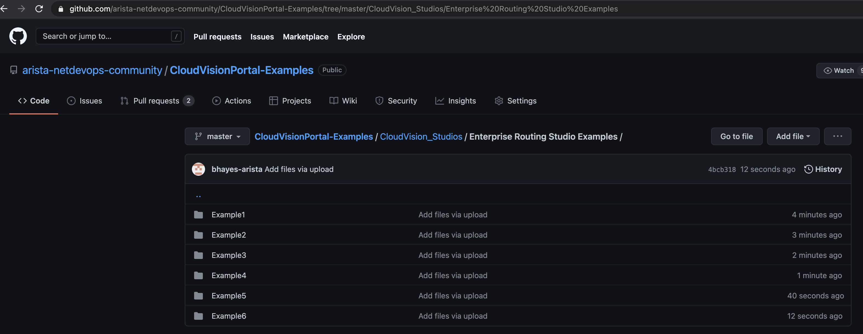
Directories with the Inputs Files for each example

Slide 5
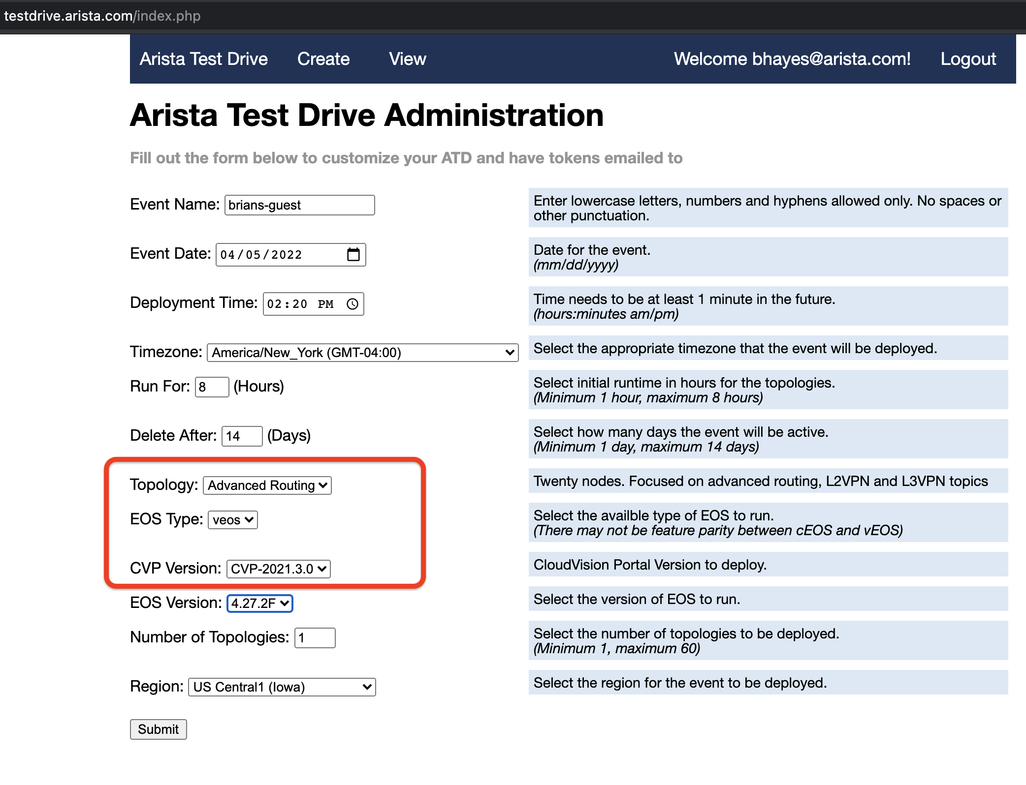
Launch the Advanced Routing ATD
https://testdrive.arista.com/

Slide 6
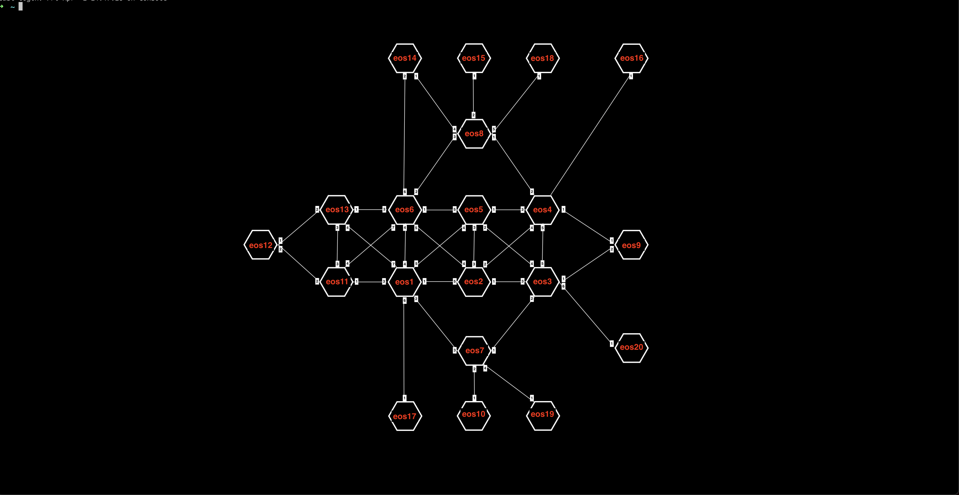
Complete Topology of the ATD
We will be using a sub-set of this topology for each Enterprise Routing Studio example

Slide 7
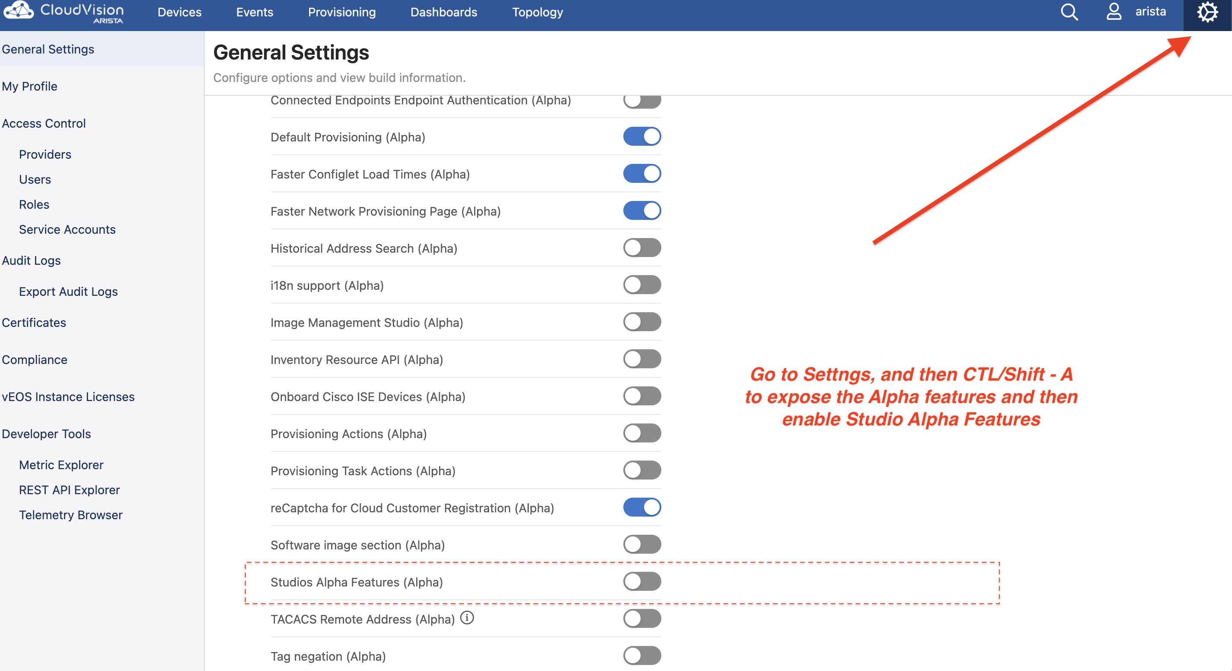
Enable Export/Import of Studios data files This is an Alpha feature and needs to be enabled in the current ATD release. This allows the example files that go with these slides to be loaded.

Slide 8
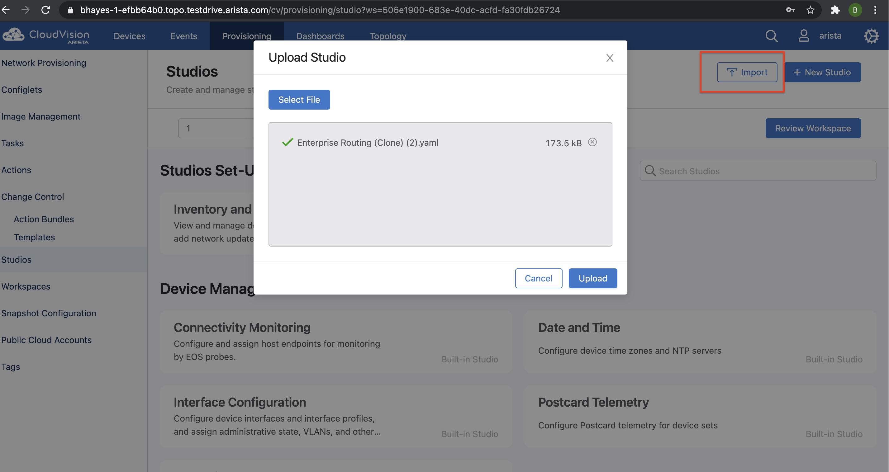
Import Enterprise Routing Studio into ATD
Once Kent version of CV is released this step is not needed because the Enterprise Routing will be a "Built-In Studio".
File location:
https://github.com/arista-netdevops-community/CloudVisionPortal-Examples/tree/master/CloudVision_Studios/Enterprise%20Routing

Slide 9
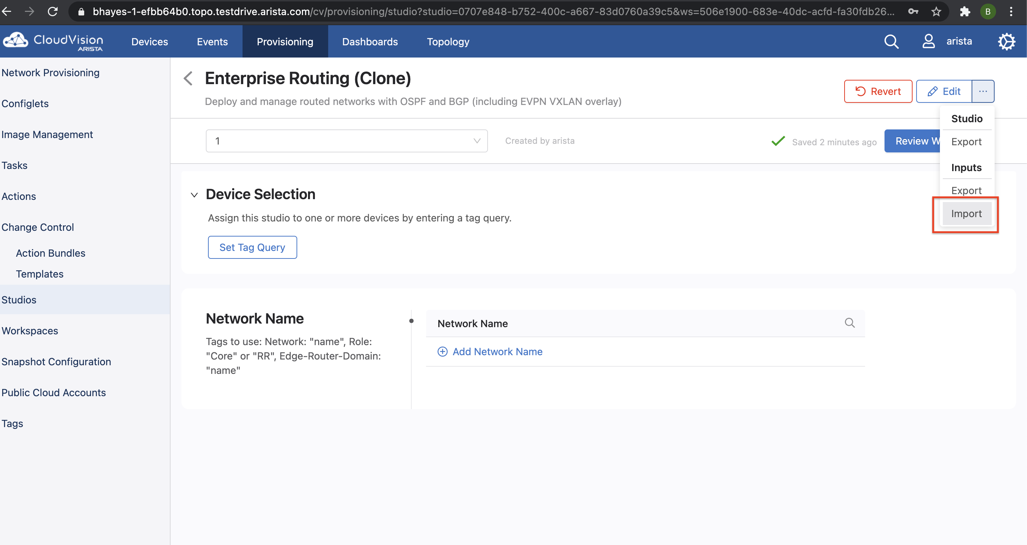
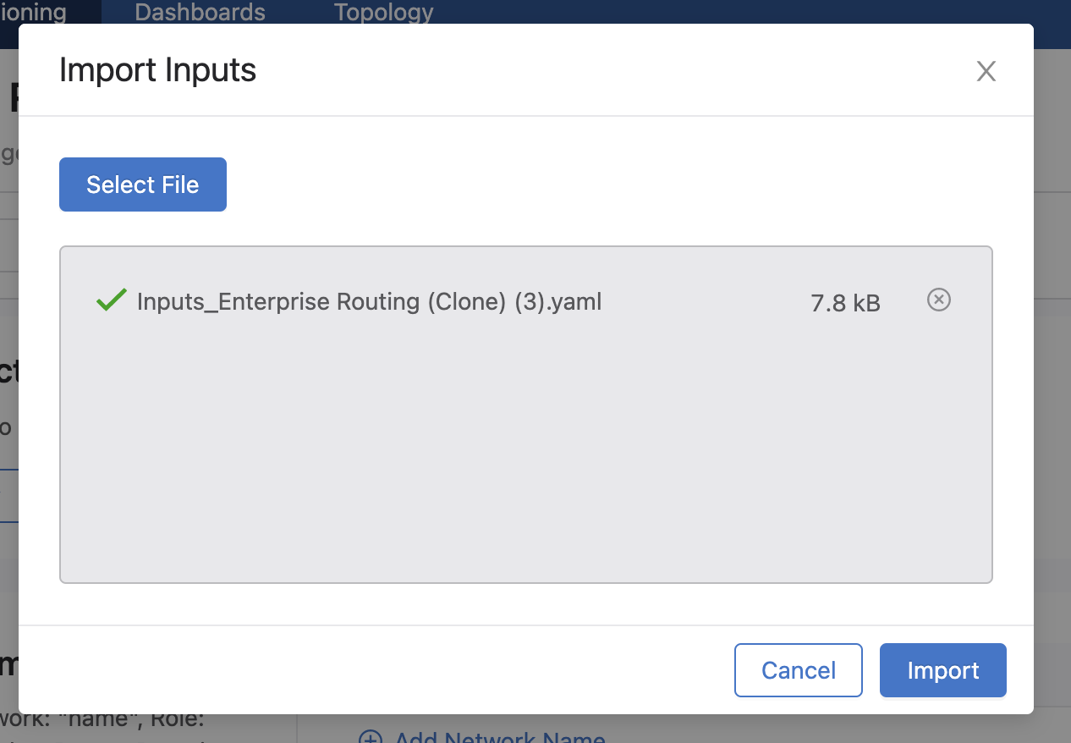
Import the Inputs for each Studio for each example
These files should be on your laptop
All Files found here:
https://github.com/arista-netdevops-community/CloudVisionPortal-Examples/tree/master/CloudVision_Studios/Enterprise%20Routing%20Studio%20Examples
Note: The interface configuration built-in studio has a bug, please use the fixed version found in the above repository

Slide 10
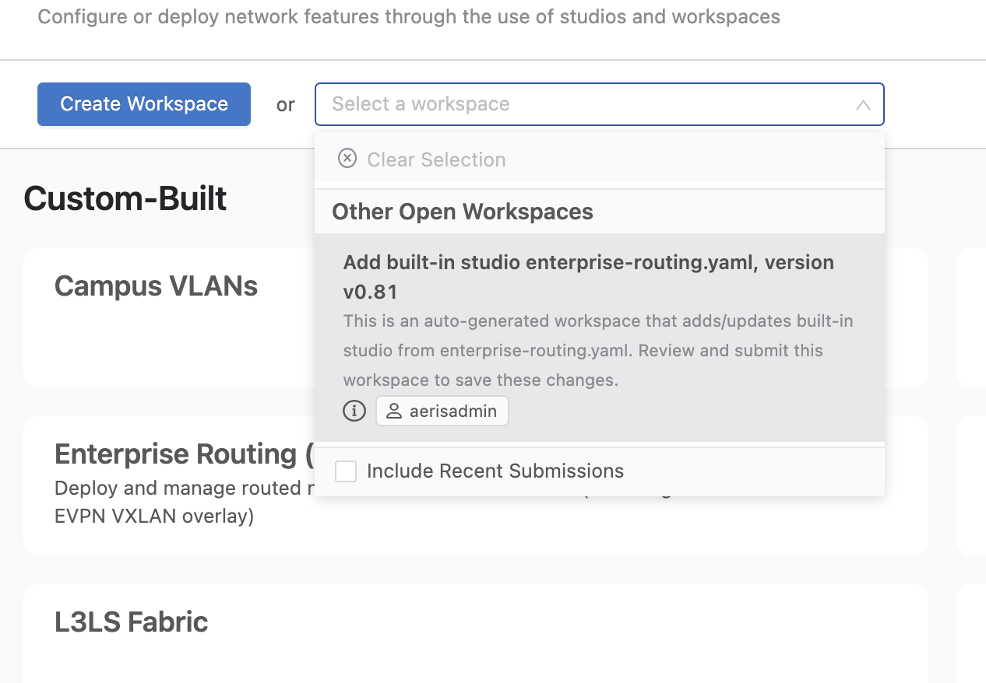
Note: If upgrading to Kent Submit new Studio Submitting this workspace adds the new Studio

Slide 11
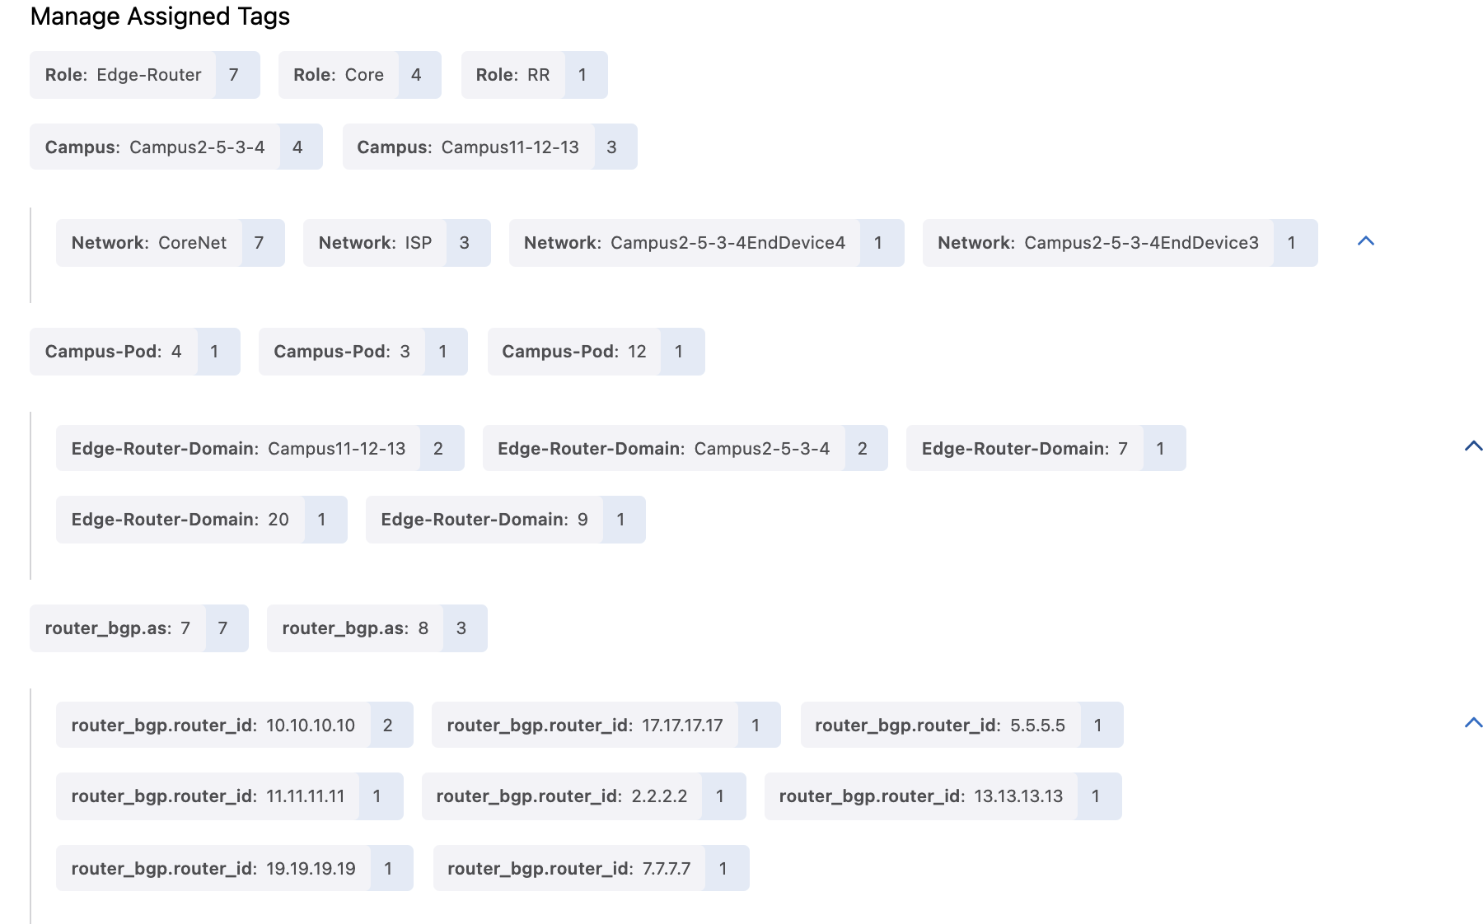
Note: Some Tags are created by Studios
L3LS Studio and Enterprise Routing Studio will set ASN tags. The user does not need to create them.
L3LS Studio will set these lo0/router ID Tags. The user must create them in the Enterprise Routing Studio if using ISIS or EVPN.

Slide 12
Other Notes
Be sure to accept "updates" in the Inventory and Topology Studio prior to Selecting devices in each Studio
Be sure to check that the drop down fields in EVPN Services and Inventory Studio are populated – Jackson release had a problem with this
When changing between example be sure to clear the arp cache in the end devices prior to sending a ping – the mac of the gw may have changed
Use the version of Interface Studio on the github site – it fixes a bug where when changing from a routed port to bridged port is missing the "switchport" command
Both the router_bgp.as Tag and the router_bgp.router_id Tag (for lo0) are written by the L3LS Studio and do not have to be entered by the user. If Enterprise Routing Studio has EVPN/VXLAN enabled the router_bgp.router_id (lo0) tag must be added
Tag Role:Edge-Router is only available in CV version Kent and beyond. If using Jackson release please ignore this tag

Slide 13
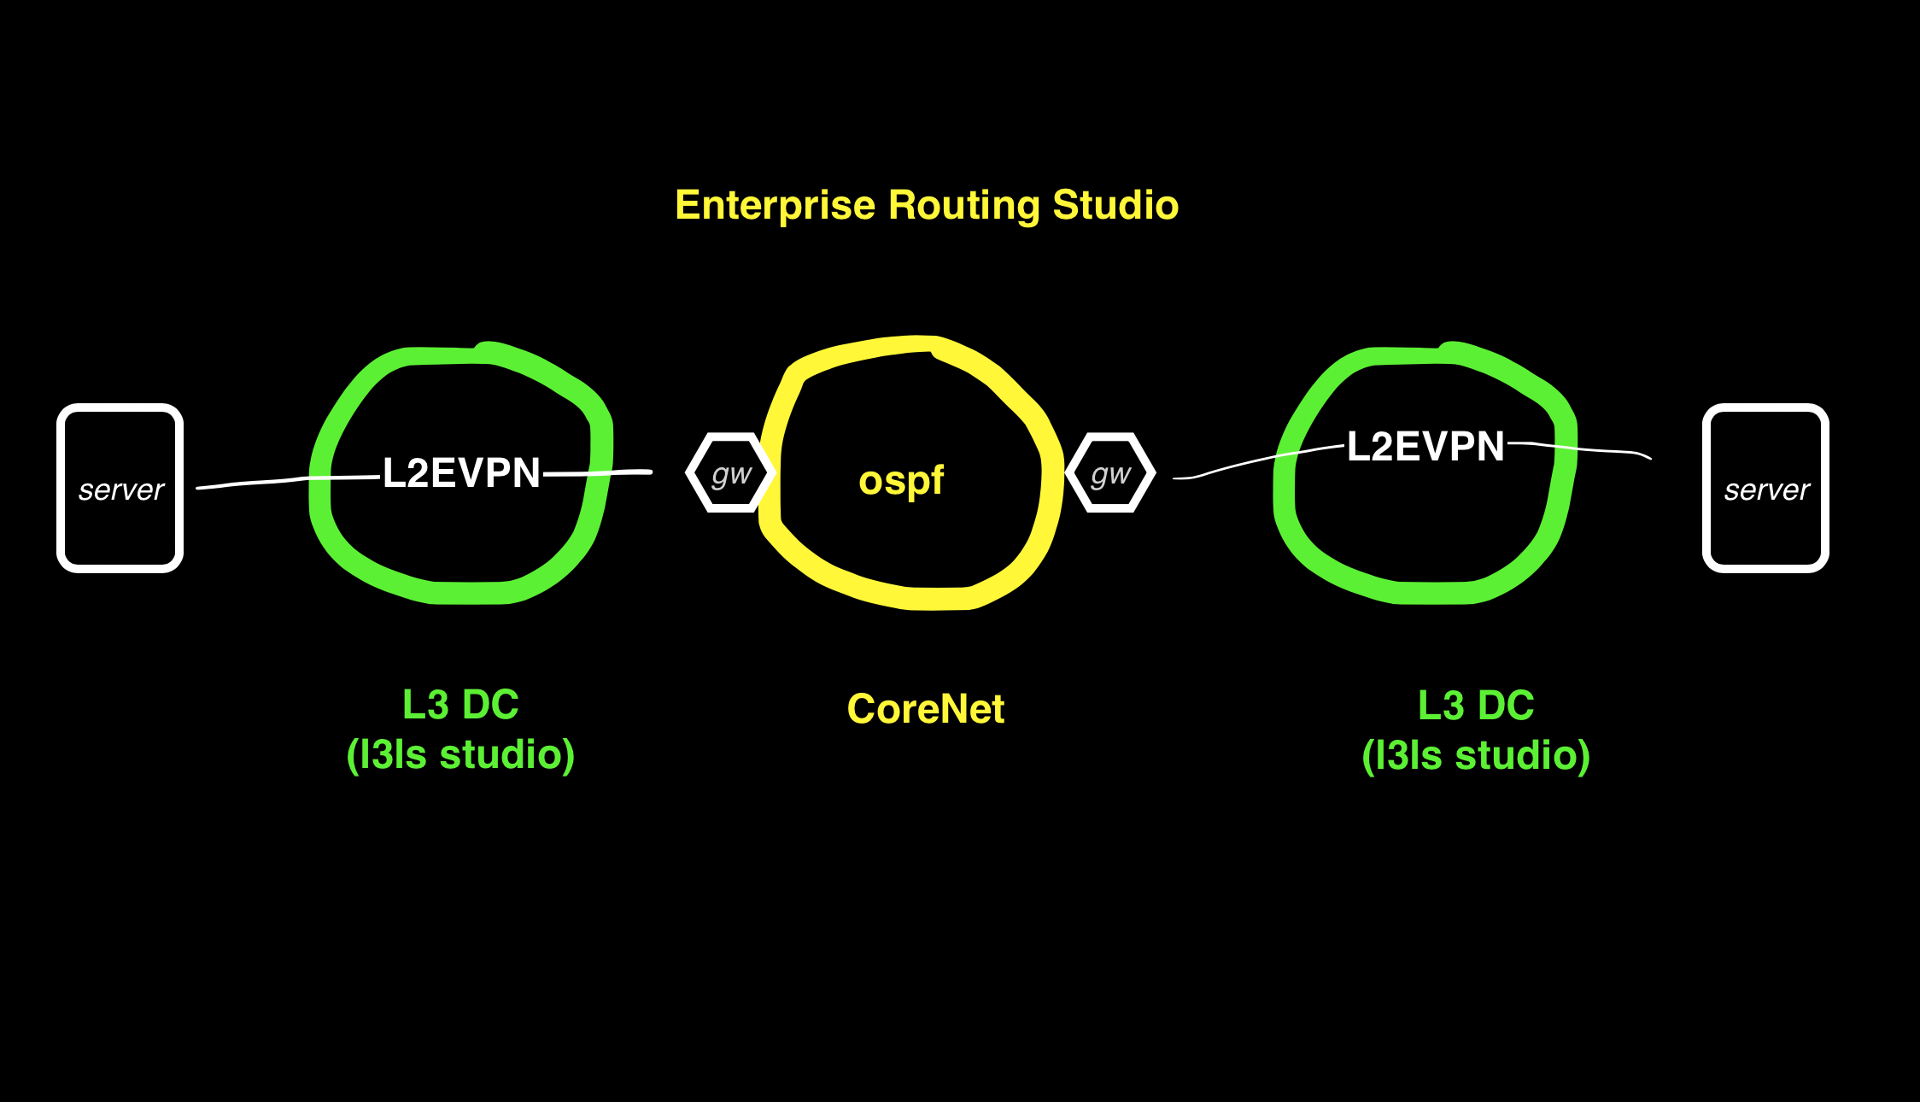
Example 1 Routing between DCs with L2EVPN

Slide 14
Example1: Routing Between 2 Data Centers L2 EVPN and L3 Edge on Enterprise Routers
In this example the Enterprise Routing Studio, consisting of a Core Router and 2 Edge Routers, connects 2 DC together
The DC border leafs have a trunk port to Edge Router and another leaf has a trunk to the end device
A vlan in 1 DC containing the end device is routed to a different vlan in another DC
Each vlan is a L2 EVPN in Each DC with the end device and the Edge Router in the VPN.
The Edge Router is the default gw for end devices in each DC. (A switch is used for the end device to launch pings from)
Example2 and example3 build on example 1

Slide 15
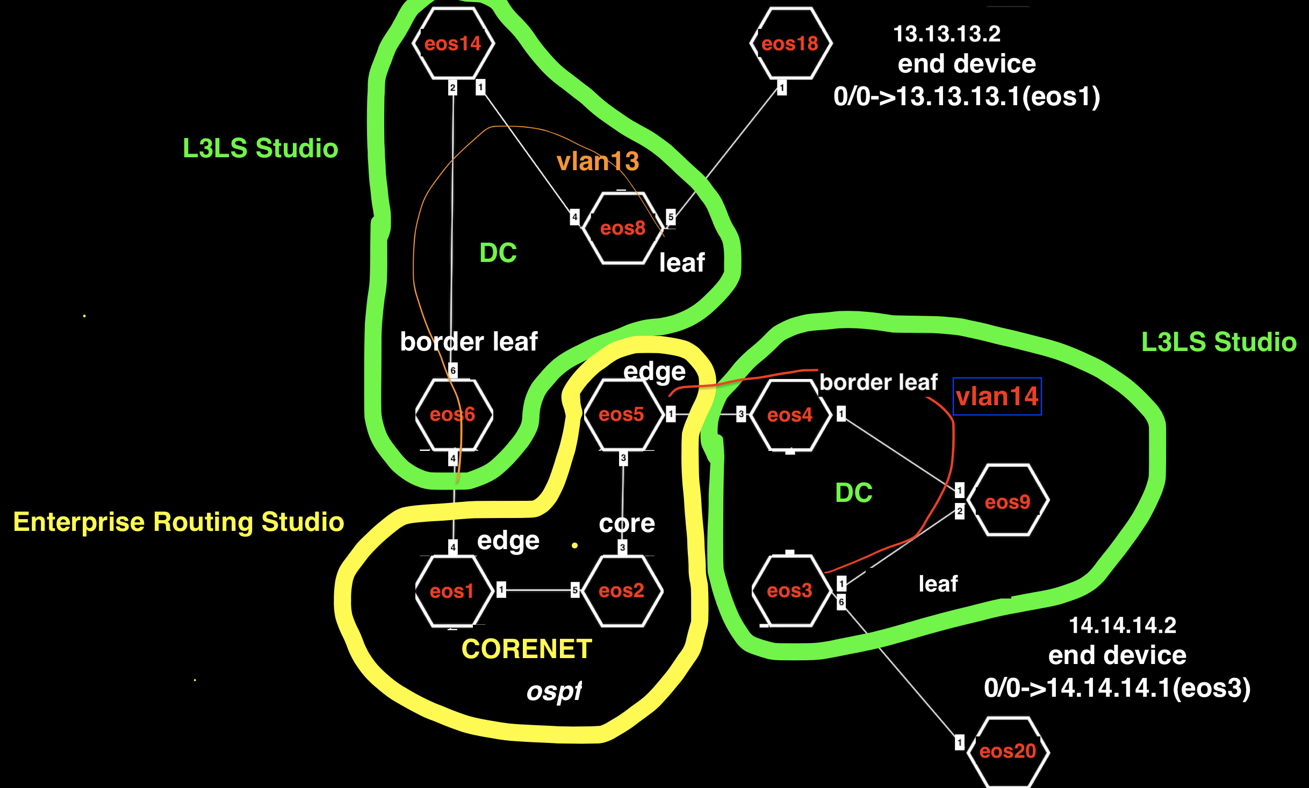
Example1

Slide 16
Example1 Tags
 | eos1 | eos2 | eos5 | eos6 | eos14 | eos8 | eos3 | eos4 | eos9 | eos18 | eos20
Network Tag | Network:CoreNet | Network:CoreNet | Network:CoreNet |  |  |  |  |  |  | Network:DC14-6-8End-device | Network:DC9-3-4End-device
Role Tag | Role:Edge-Router | Role:Core | Role:Edge-Router | Role:Leaf | Role:Spine | Role:Leaf | Role:Leaf | Role:Leaf | Role:Spine | Role:Edge-Router | Role:Edge-Router
Edge Router Domain Tag | Edge-Router-Domain:1 |  | Edge-Router-Domain:5 |  |  |  |  |  |  | Edge-Router-Domain:18 | Edge-Router-Domain:20
DC Tag |  |  |  | DC:14-6-8 | DC:14-6-8 | DC:14-6-8 | DC:9-4-3 | DC:9-4-3 | DC:9-4-3
DC-Pod Tag |  |  |  | DC-Pod:1 | DC-Pod:1 | DC-Pod:1 | DC-Pod:2 | DC-Pod:2 | DC-Pod:2
Leaf Domain |  |  |  | Leaf-Domain:1 |  | Leaf-Domain:2 | Leaf-Domain:3 | Leaf-Domain:4
Number |  |  |  | Leaf-Number:1 | Spine-Number:1 | Leaf-Number:2 | Leaf-Number:1 | Leaf-Number:2 | Spine-Number:1

Slide 17
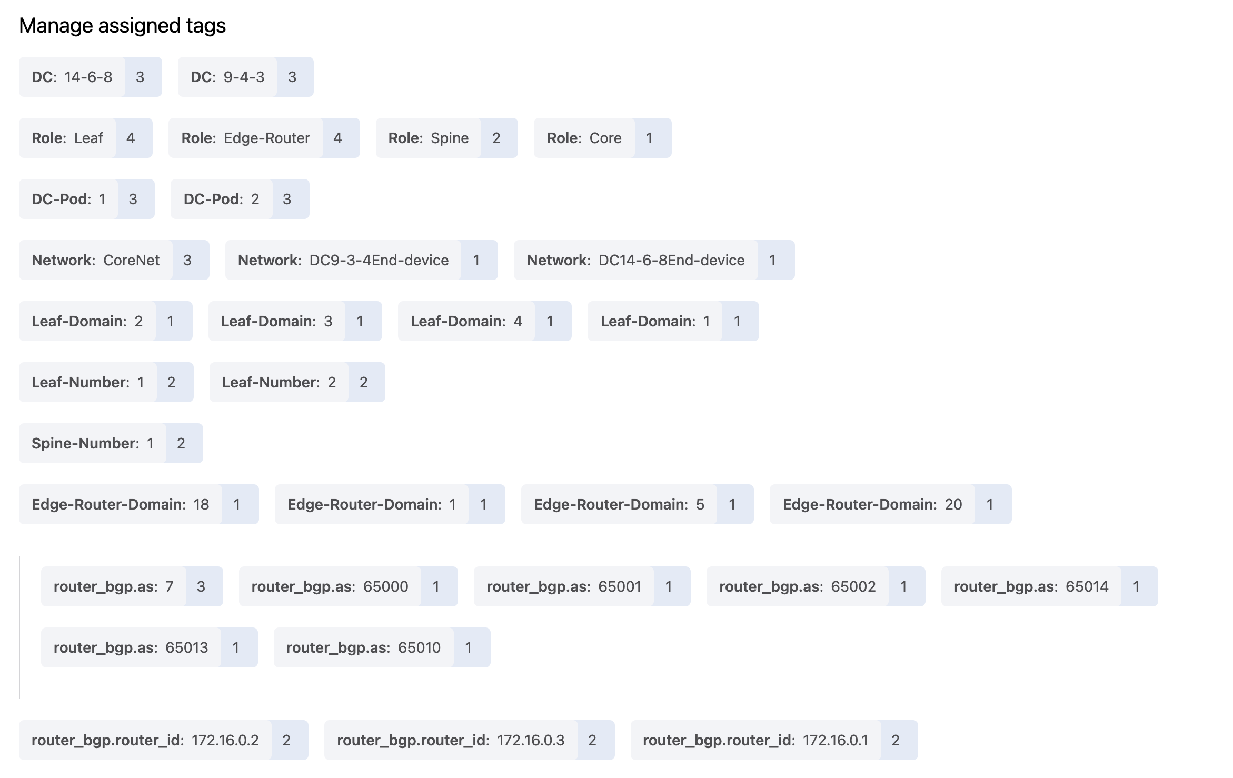

Slide 18
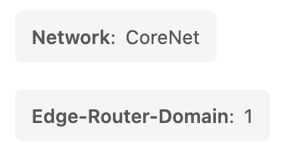
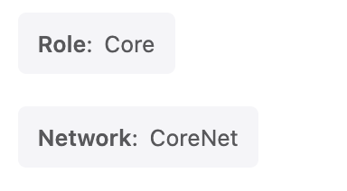

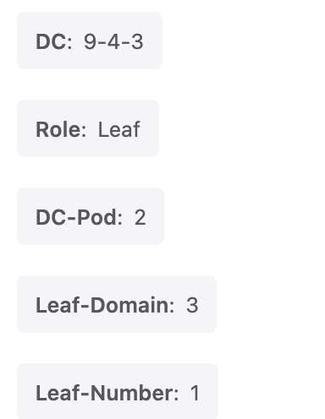

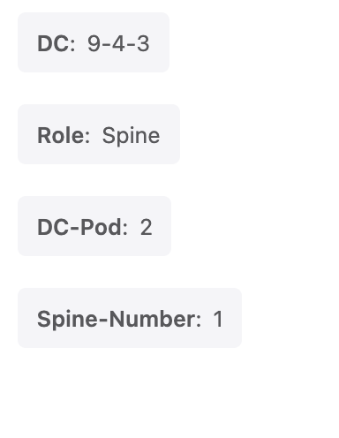

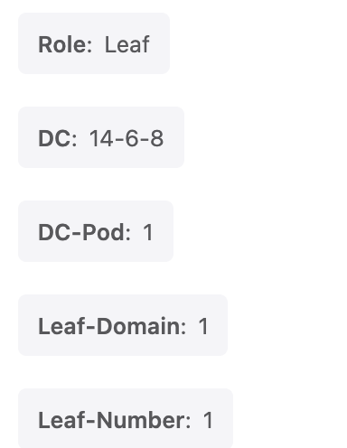
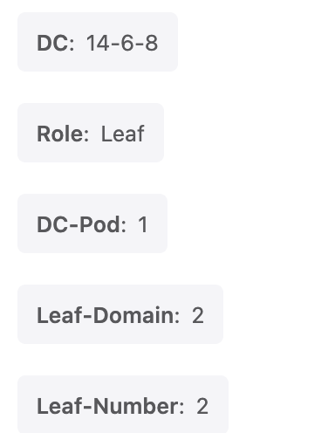
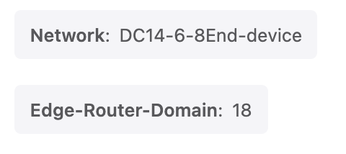
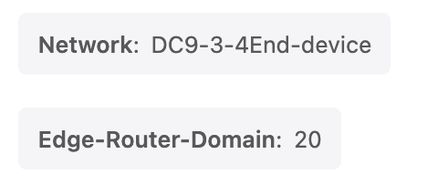
TAGs for example 1
eos1
eos2
eos5
eos3
eos4
eos9
eos14
eos6
eos8
eos18
eos20

Slide 19
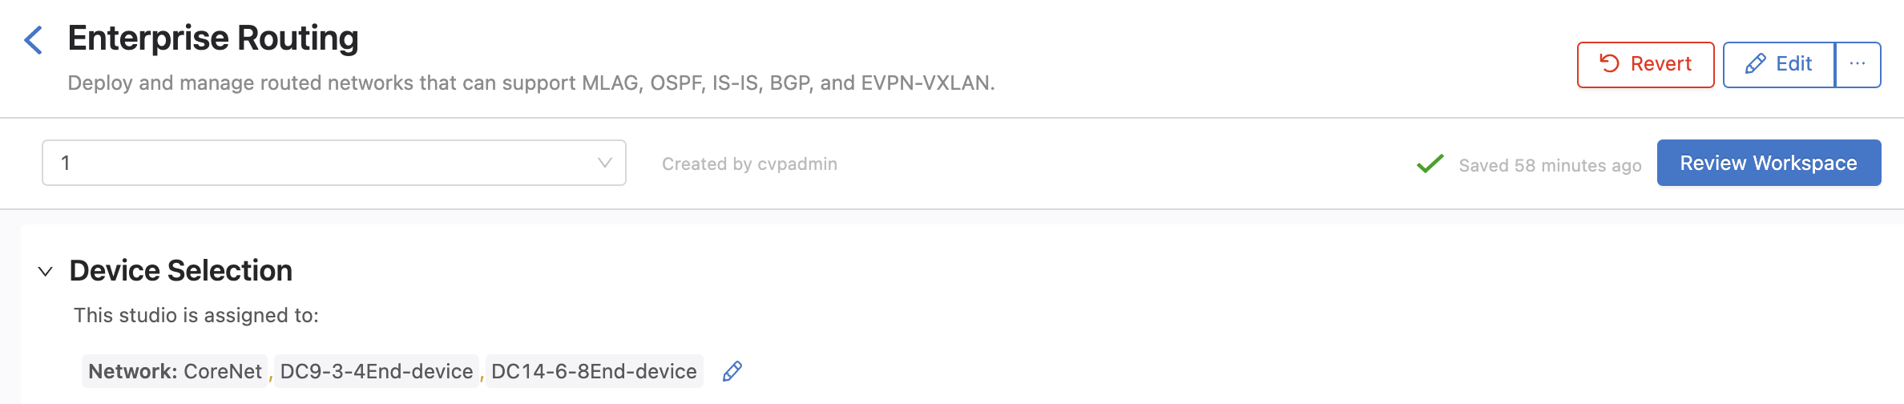
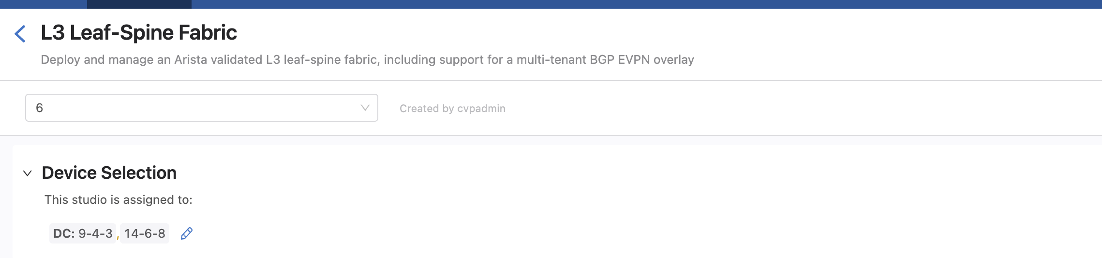
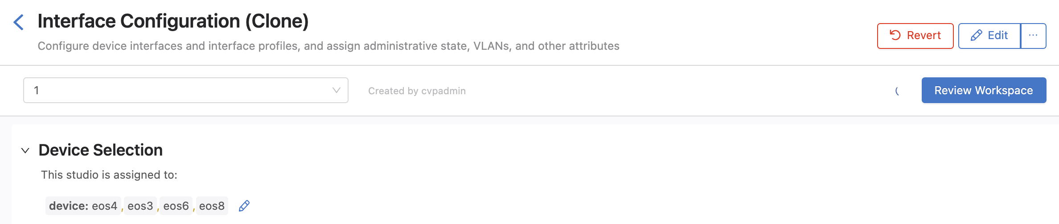
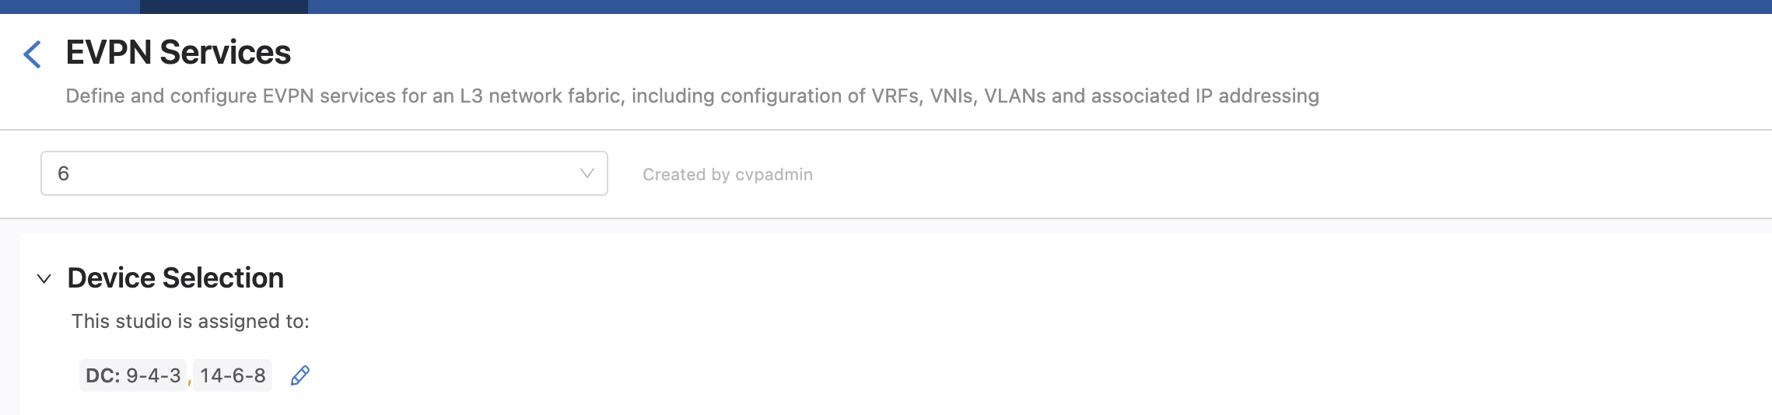
Device Selection

Slide 20
Test
From eos18 ping eos20 14.14.14.2

Slide 21
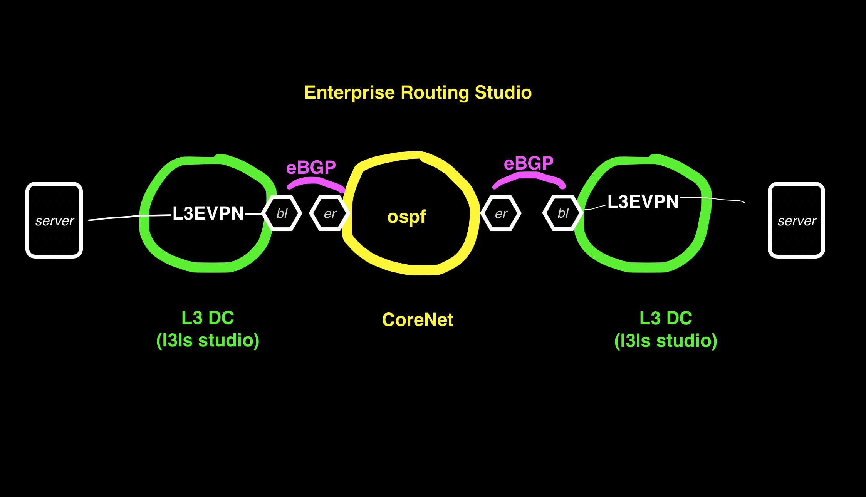
Example 2 Routing eBGP between DCs eBGP between border Leaf and Edge Router

Slide 22
Example2: Routing Between 2 Data Centers L3EVPN and eBGP from Border Leaf to Enterprise Router
In this example the Enterprise Routing Studio, consisting of a Core Router and 2 Edge Routers, connects 2 DC together
The DC border leafs have a trunk port to Edge Router and another leaf has a trunk to the end device
A vlan in 1 DC containing the end device is routed to a different vlan in another DC
Each vlan is a L3 EVPN in Each DC with the end device and the Edge Router in the VPN.
The Edge Router is the default gw for end devices in each DC. (A switch is used for the end device to ping from)
Ping from eos18 13.13.13.2/24 to eos 20 14.14.14.2/24

Slide 23
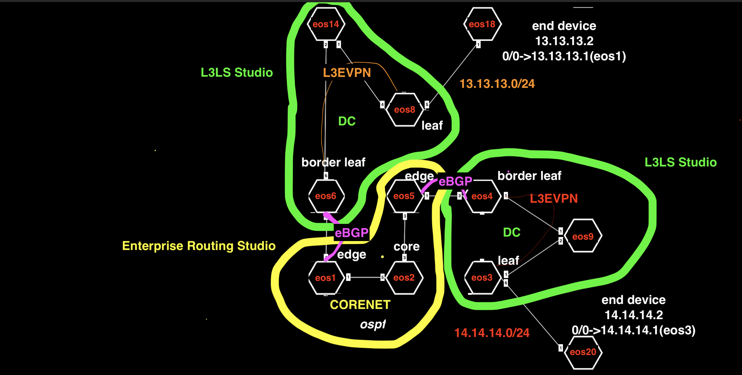
Example2

Slide 24
Example 2 Tags
 | eos1 | eos2 | eos5 | eos6 | eos14 | eos8 | eos3 | eos4 | eos9 | eos18 | eos20
Network Tag | Network:CoreNet | Network:CoreNet | Network:CoreNet | Network:DC14-6-8Border-Leaf |  |  |  | Network:DC9-3-4Border-Leaf |  | Network:DC14-6-8End-device | Network:DC9-3-4End-device
Role Tag | Role:Edge-Router | Role:Core | Role:Edge-Router | Role:Edge-Router | Role:Spine | Role:Leaf | Role:Leaf | Role:Edge-Router | Role:Spine | Role:Edge-Router | Role:Edge-Router
Other Role Tag |  |  |  | Role:Leaf |  |  |  | Role:Leaf
Edge Router Domain Tag | Edge-Router-Domain:1 |  | Edge-Router-Domain:5 | Edge-Router-Domain:6 |  |  |  | Edge-Router-Domain:4 |  | Edge-Router-Domain:18 | Edge-Router-Domain:20
DC Tag |  |  |  | DC:14-6-8 | DC:14-6-8 | DC:14-6-8 | DC:9-4-3 | DC:9-4-3 | DC:9-4-3
DC Pod Tag |  |  |  | DC-Pod:1 | DC-Pod:1 | DC-Pod:1 | DC-Pod:2 | DC-Pod:2 | DC-Pod:2
Leaf Domain |  |  |  | Leaf-Domain:1 |  | Leaf-Domain:2 | Leaf-Domain:3 | Leaf-Domain:4
Number |  |  |  | Leaf-Number:1 | Spine-Number:1 | Leaf-Number:2 | Leaf-Number:1 | Leaf-Number:2 | Spine-Number:1

Slide 25
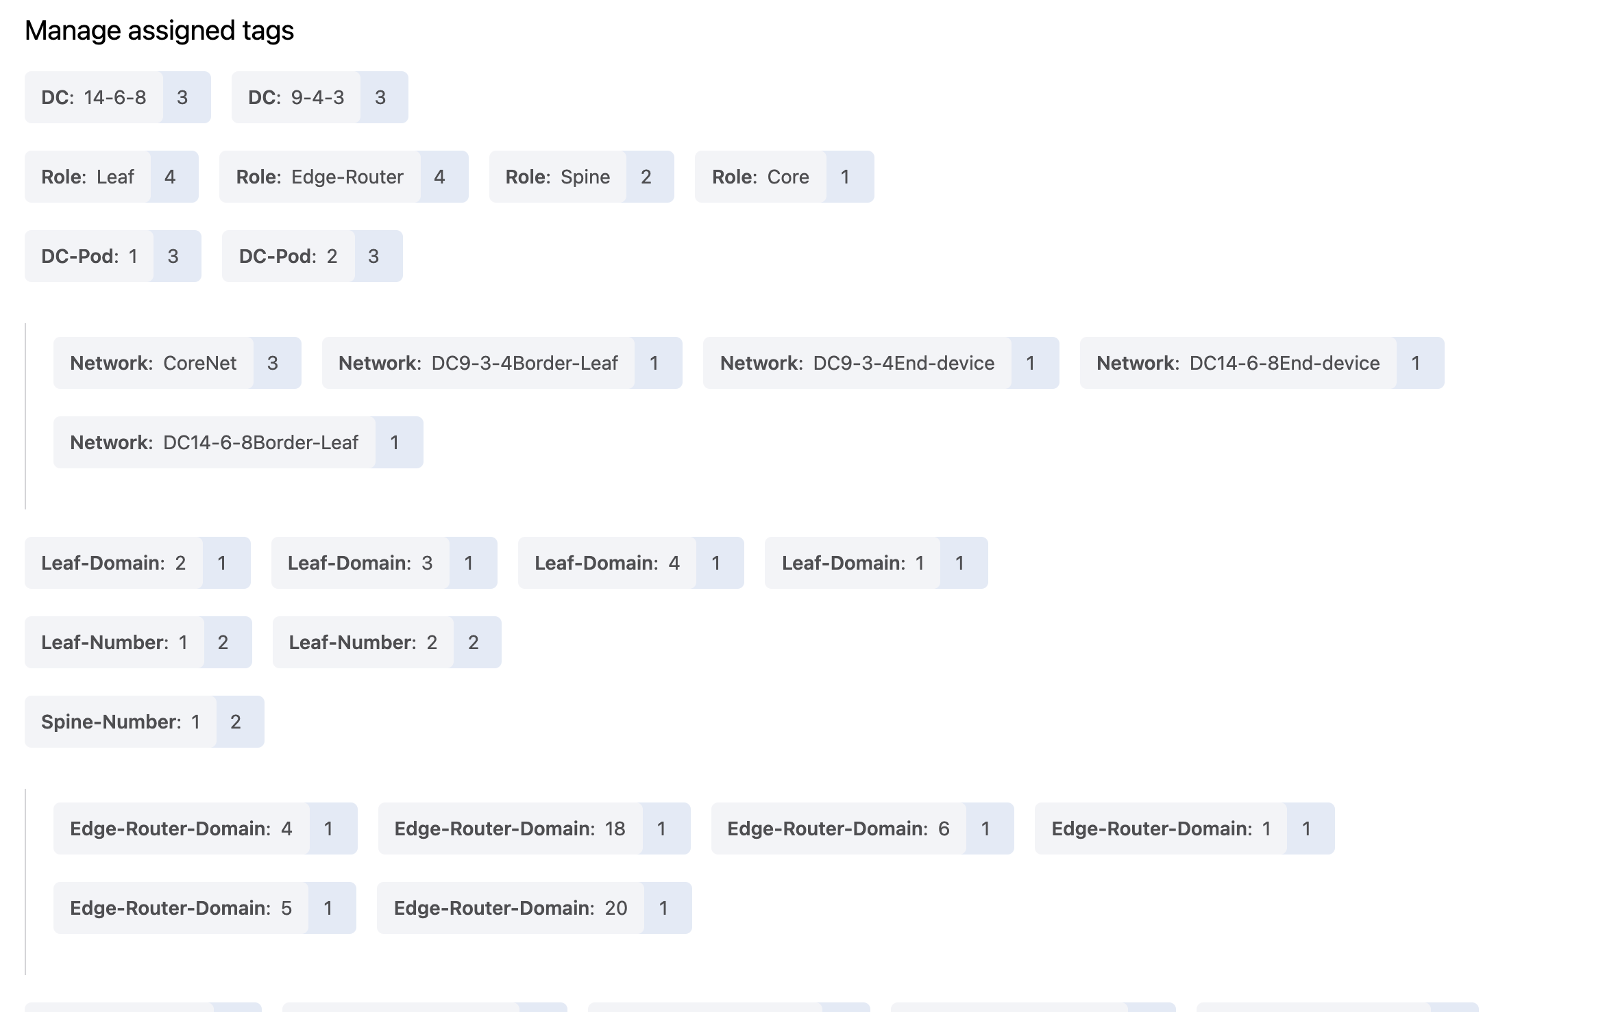

Slide 26
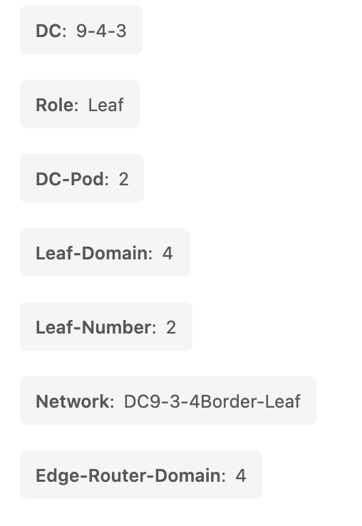
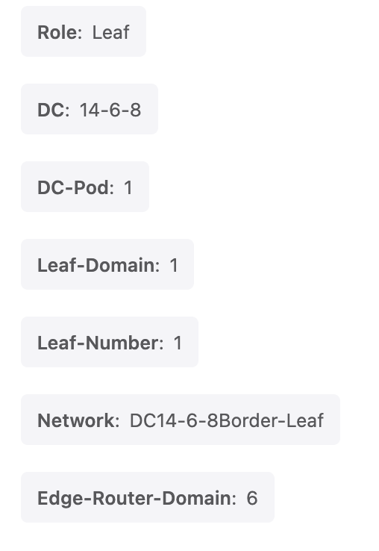
TAGs for example 2 – the DC border routers have additional tags from the previous example
eos1
eos2
eos5
eos3
eos4
eos9
eos14
eos6
eos8
eos18
eos20

Slide 27
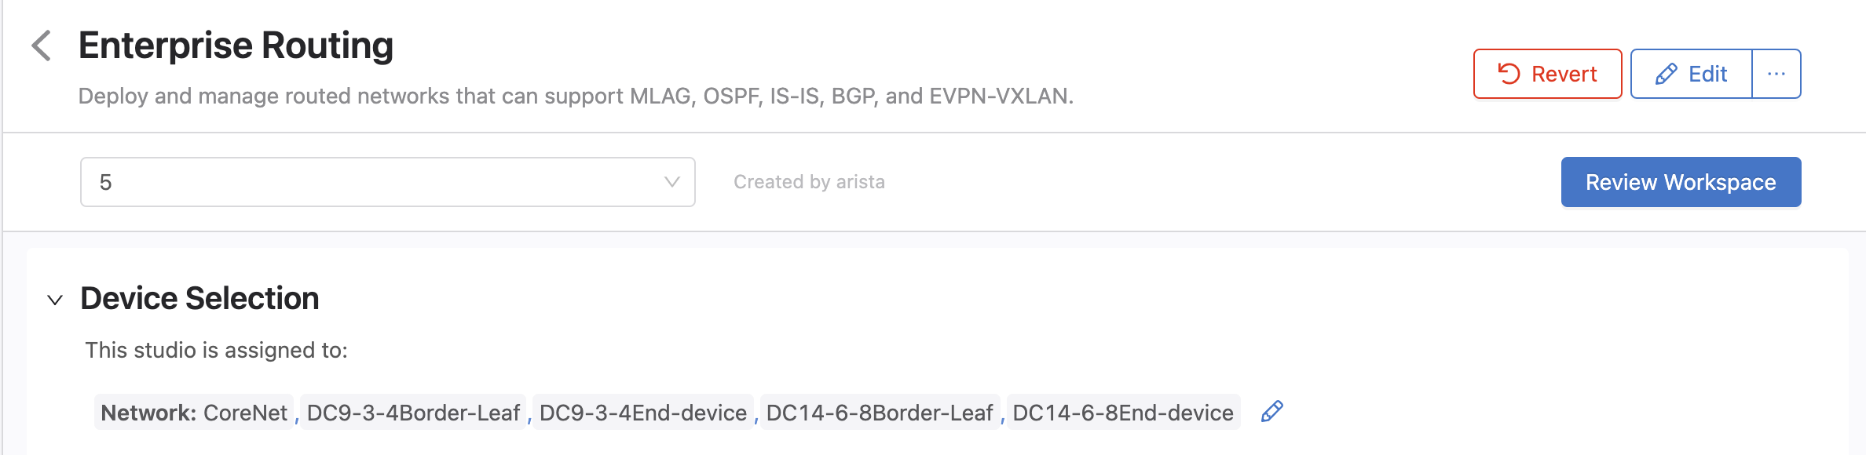
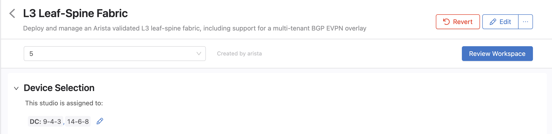
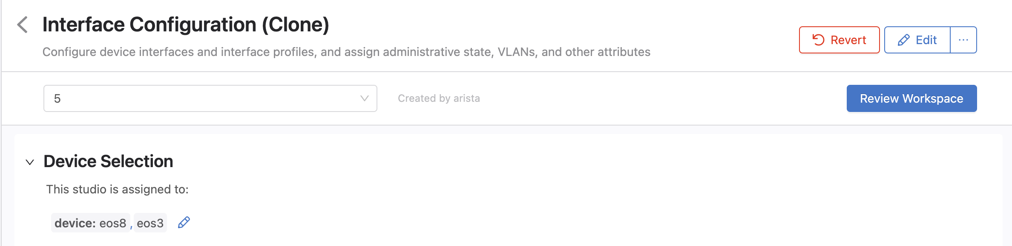
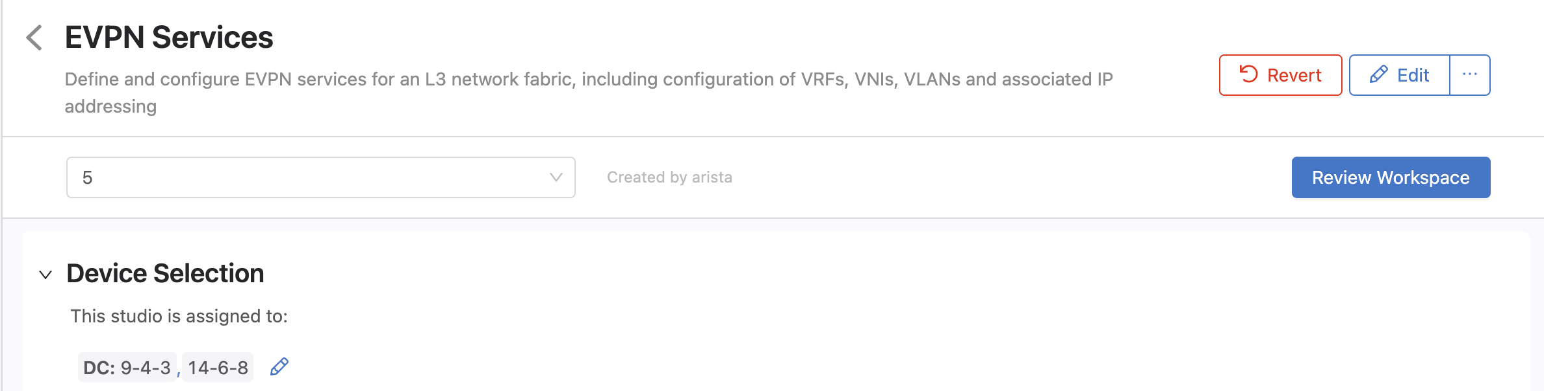
Device Selection

Slide 28
Test
From eos18 ping eos20 14.14.14.2
You may have to clear the arp cache on eos18 between the mac address of its default gateway has changed from the previous example

Slide 29
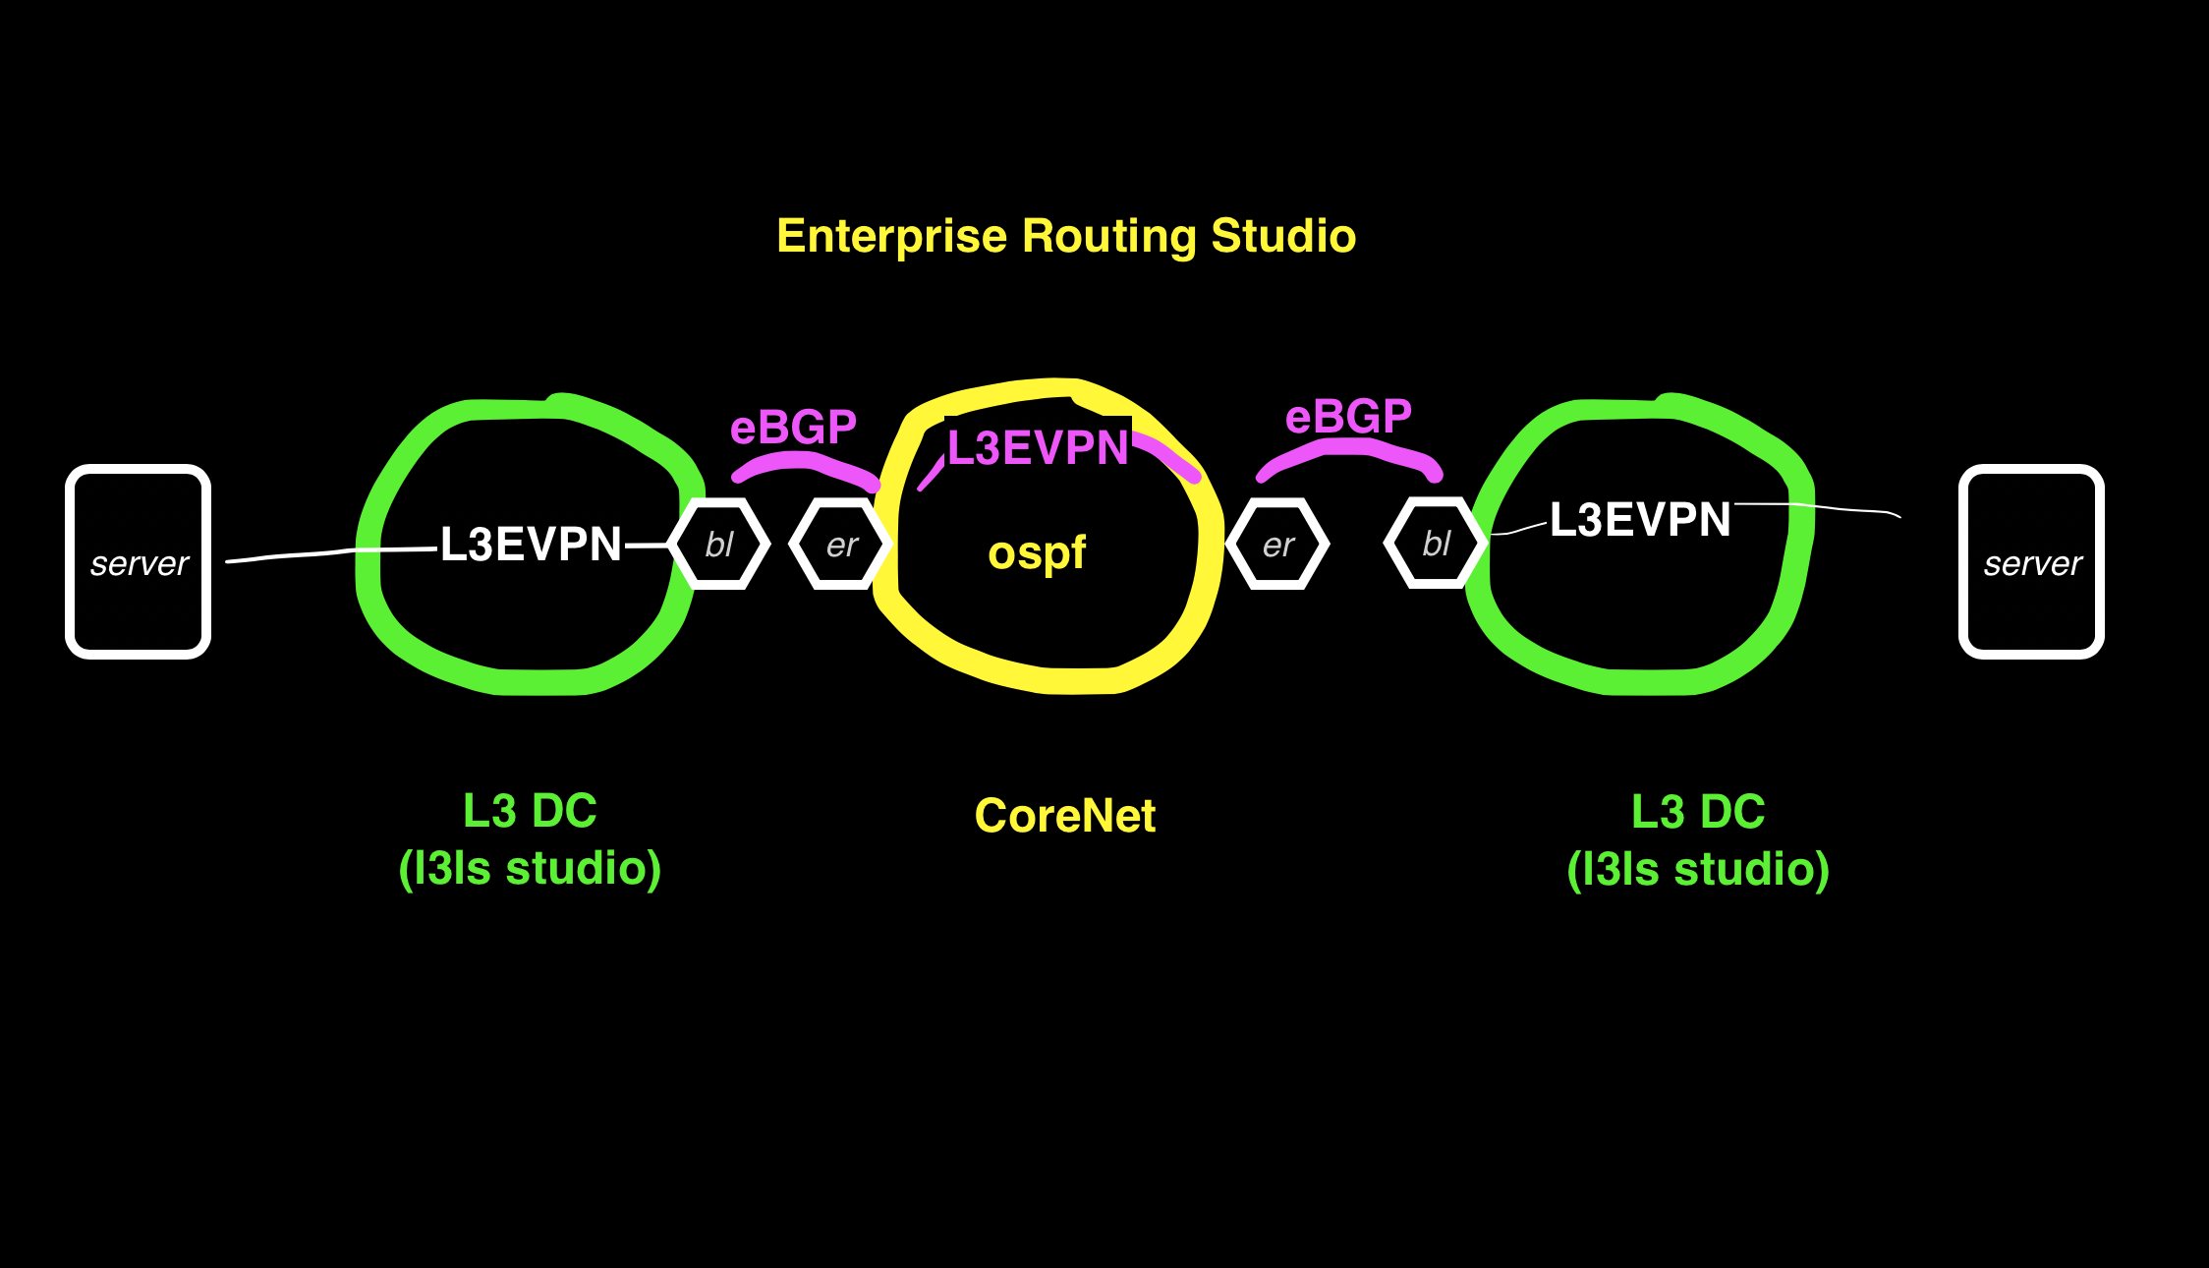
Example 3 EVPN on Enterprise Core

Slide 30
Example3: L3EVPN on CoreNet
In this example the Enterprise Routing Studio is configured to put the traffic in an L3EVPN between the DCs and over a 3rd L3EVPN segment in the Enterprise Core
The border leafs have eBGP sessions to the Edge Routers and the interface on the Edge Router side is in a VRF.
Clone the EVPN Services Studio – it will be used for the EVPN over the Enterprise Core Network. This will avoid the limitation of a vlan id cannot be reused even if it is on a different network (vlan between border leafs and edge router for example)

Slide 31
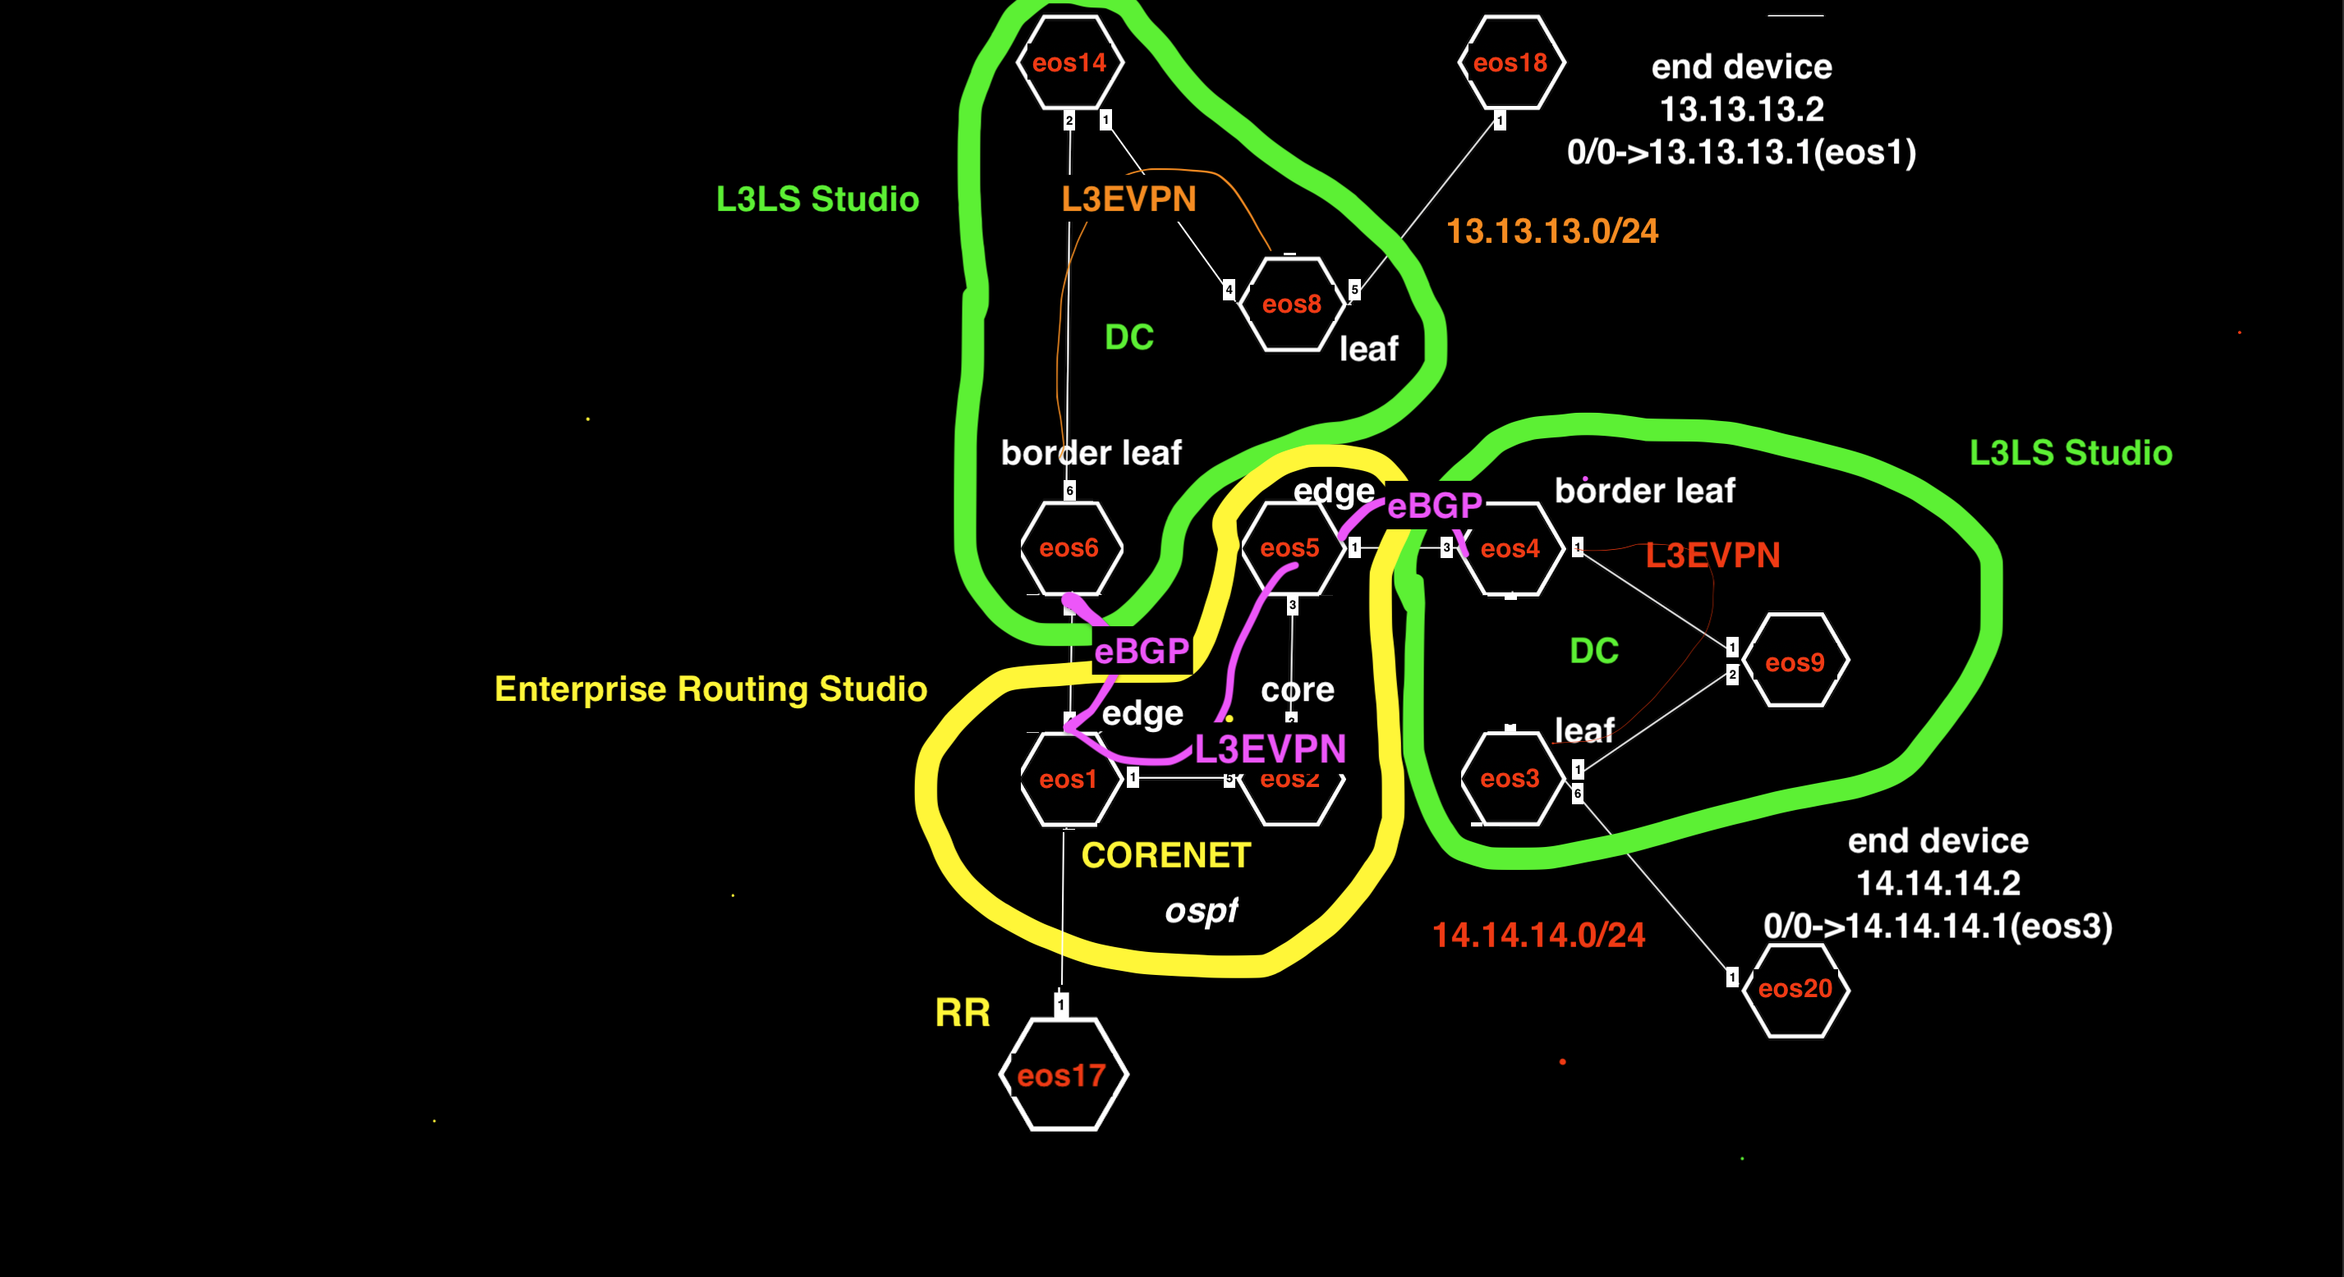
Example3: L3EVPN on Enterprise Core

Slide 32
Example3 Tags
 | eos1 | eos2 | eos5 | eos6 | eos14 | eos8 | eos3 | eos4 | eos9 | eos18 | eos20 | eos17
Network Tag | Network:CoreNet | Network:CoreNet | Network:CoreNet | Network:DC14-6-8Border-Leaf |  |  |  | Network:DC9-3-4Border-Leaf |  | Network:DC14-6-8End-device | Network:DC9-3-4End-device | Network:CoreNet
Role Tag | Role:Edge-Router | Role:Core | Role:Edge-Router | Role:Edge-Router | Role:Spine | Role:Leaf | Role:Leaf | Role:Edge-Router | Role:Spine | Role:Edge-Router | Role:Edge-Router | Role:RR
Other Role Tag |  |  |  | Role:Leaf |  |  |  | Role:Leaf
Edge Router Domain Tag | Edge-Router-Domain:1 |  | Edge-Router-Domain:5 | Edge-Router-Domain:6 |  |  |  | Edge-Router-Domain:4 |  | Edge-Router-Domain:18 | Edge-Router-Domain:20
Lo0 Tag | router_bgp.router_id:1.1.1.1 |  | router_bgp.router_id:5.5.5.5 |  |  |  |  |  |  |  |  | router_bgp.router_id:17.17.17.17
DC Tag |  |  |  | DC:14-6-8 | DC:14-6-8 | DC:14-6-8 | DC:9-4-3 | DC:9-4-3 | DC:9-4-3
DC Pod Tag |  |  |  | DC-Pod:1 | DC-Pod:1 | DC-Pod:1 | DC-Pod:2 | DC-Pod:2 | DC-Pod:2
Leaf Domain |  |  |  | Leaf-Domain:1 |  | Leaf-Domain:2 | Leaf-Domain:3 | Leaf-Domain:4
Number |  |  |  | Leaf-Number:1 | Spine-Number:1 | Leaf-Number:2 | Leaf-Number:1 | Leaf-Number:2 | Spine-Number:1

Slide 33
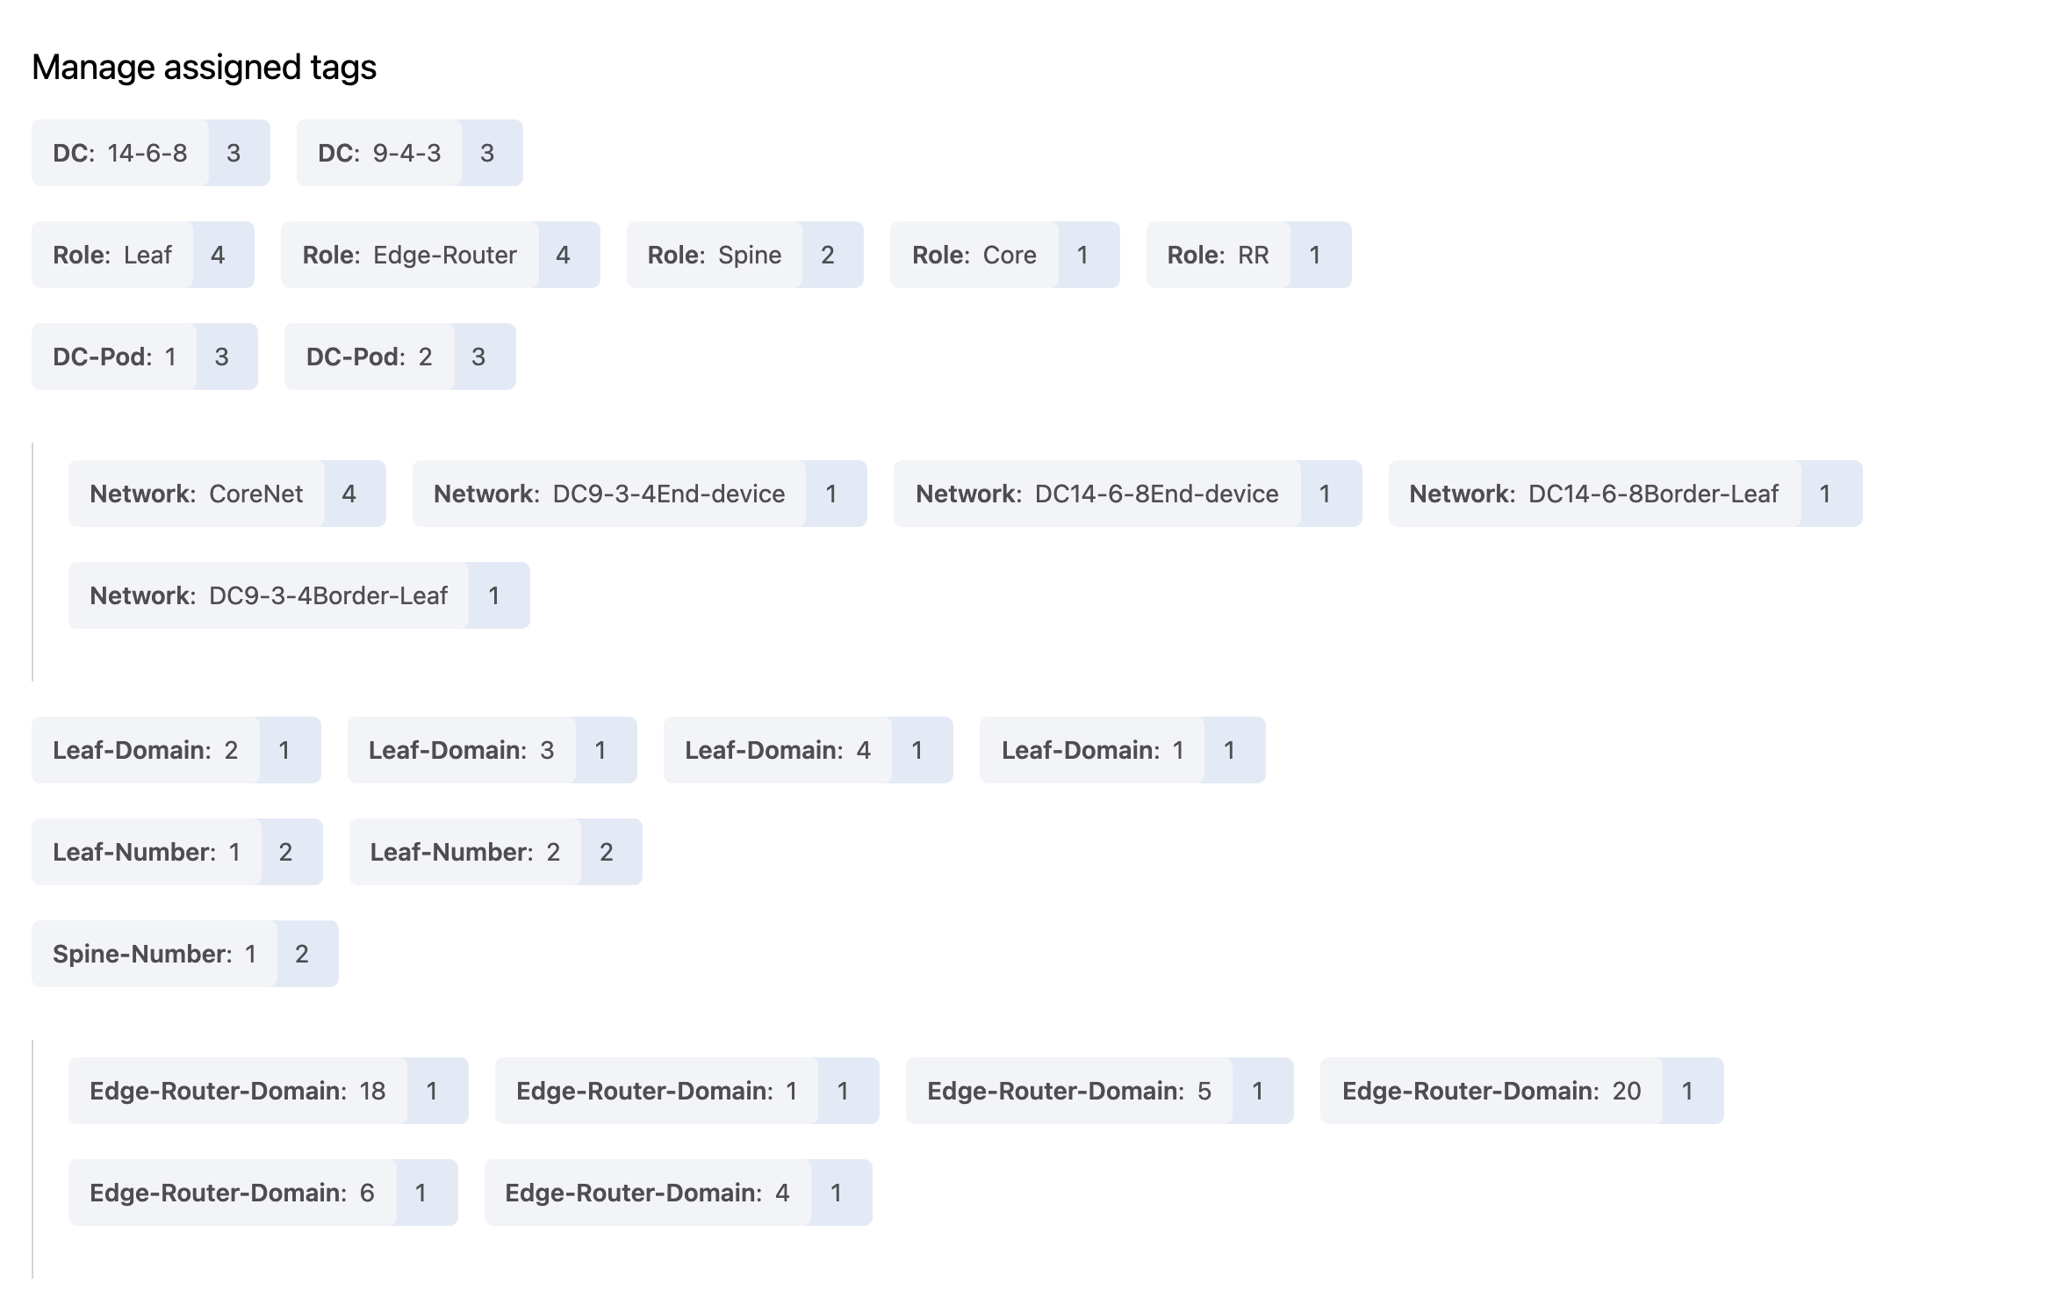

Slide 34
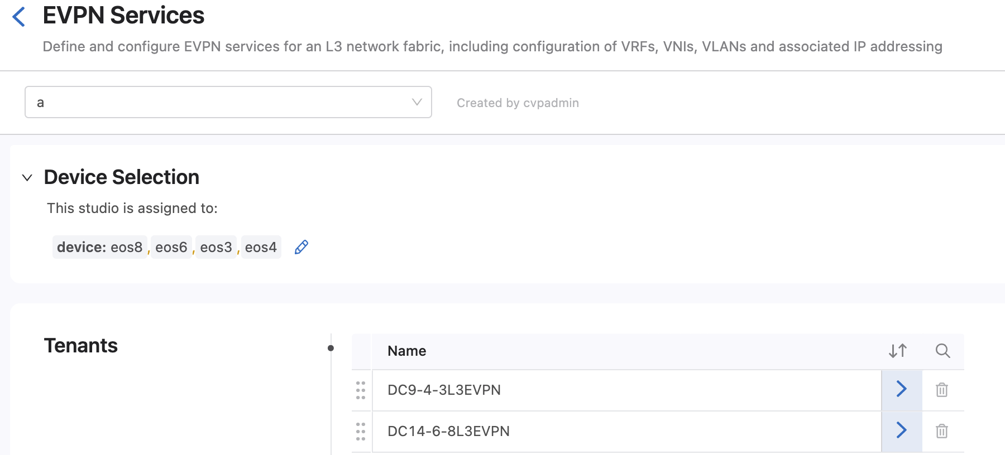
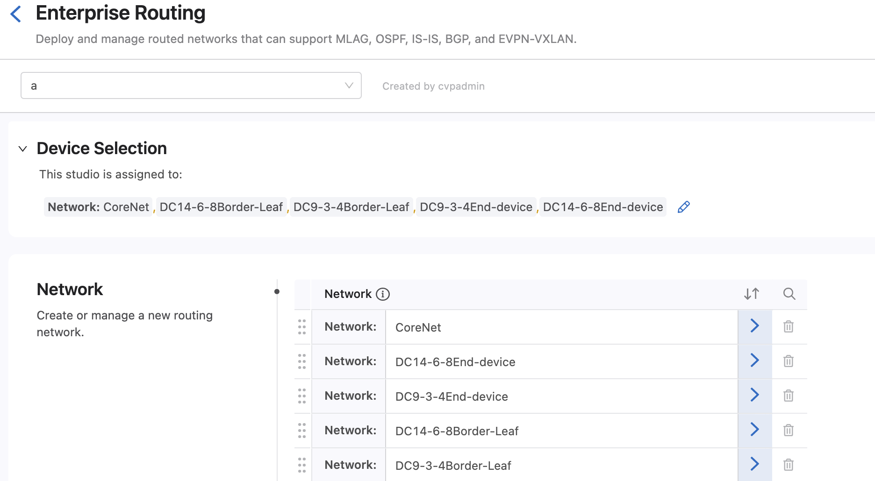
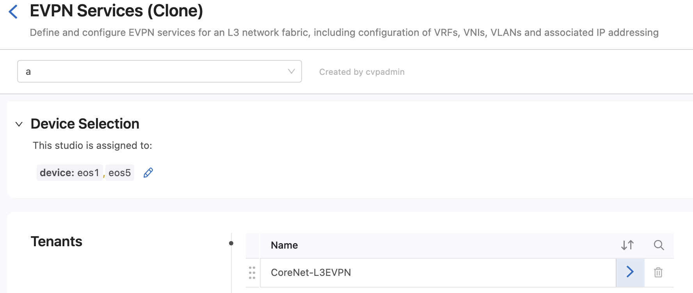
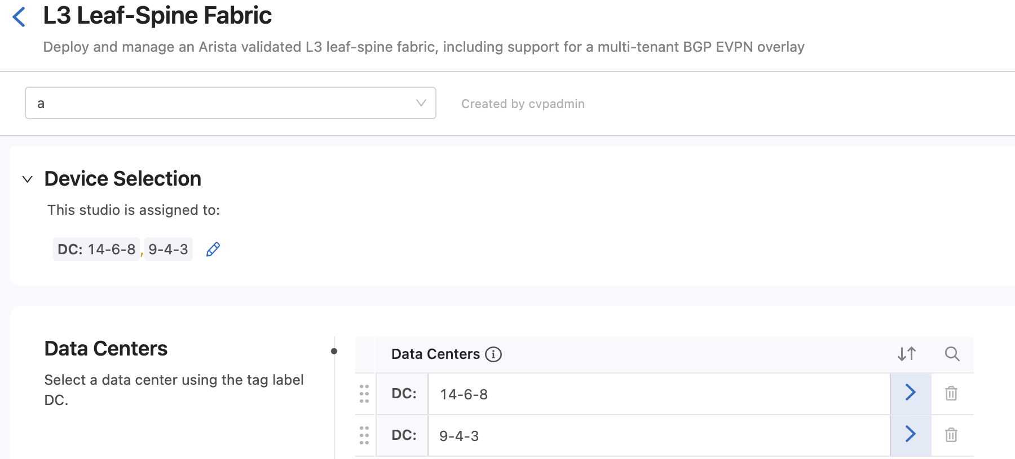
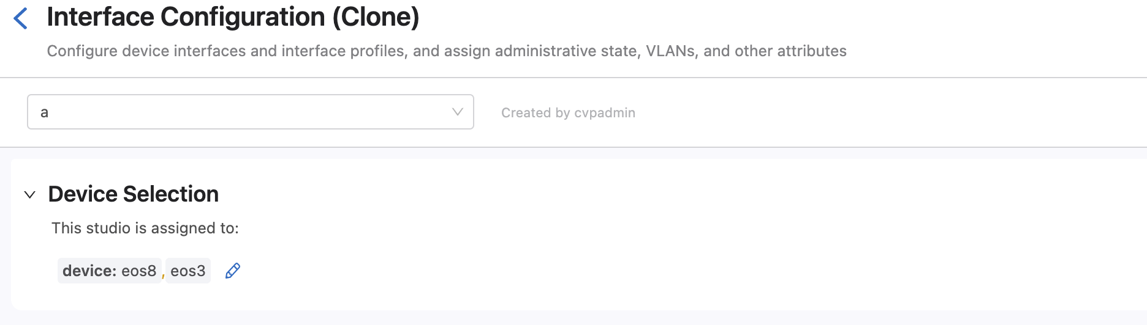
Device Selection
Clone the EVPN Services Studio. This clone will be used for the EVPN over the Enterprise Core Network

Slide 35
Test
From eos18 ping eos20 14.14.14.2
You may have to clear the arp cache on eos18 between the mac address of its default gateway has changed from the previous example

Slide 36
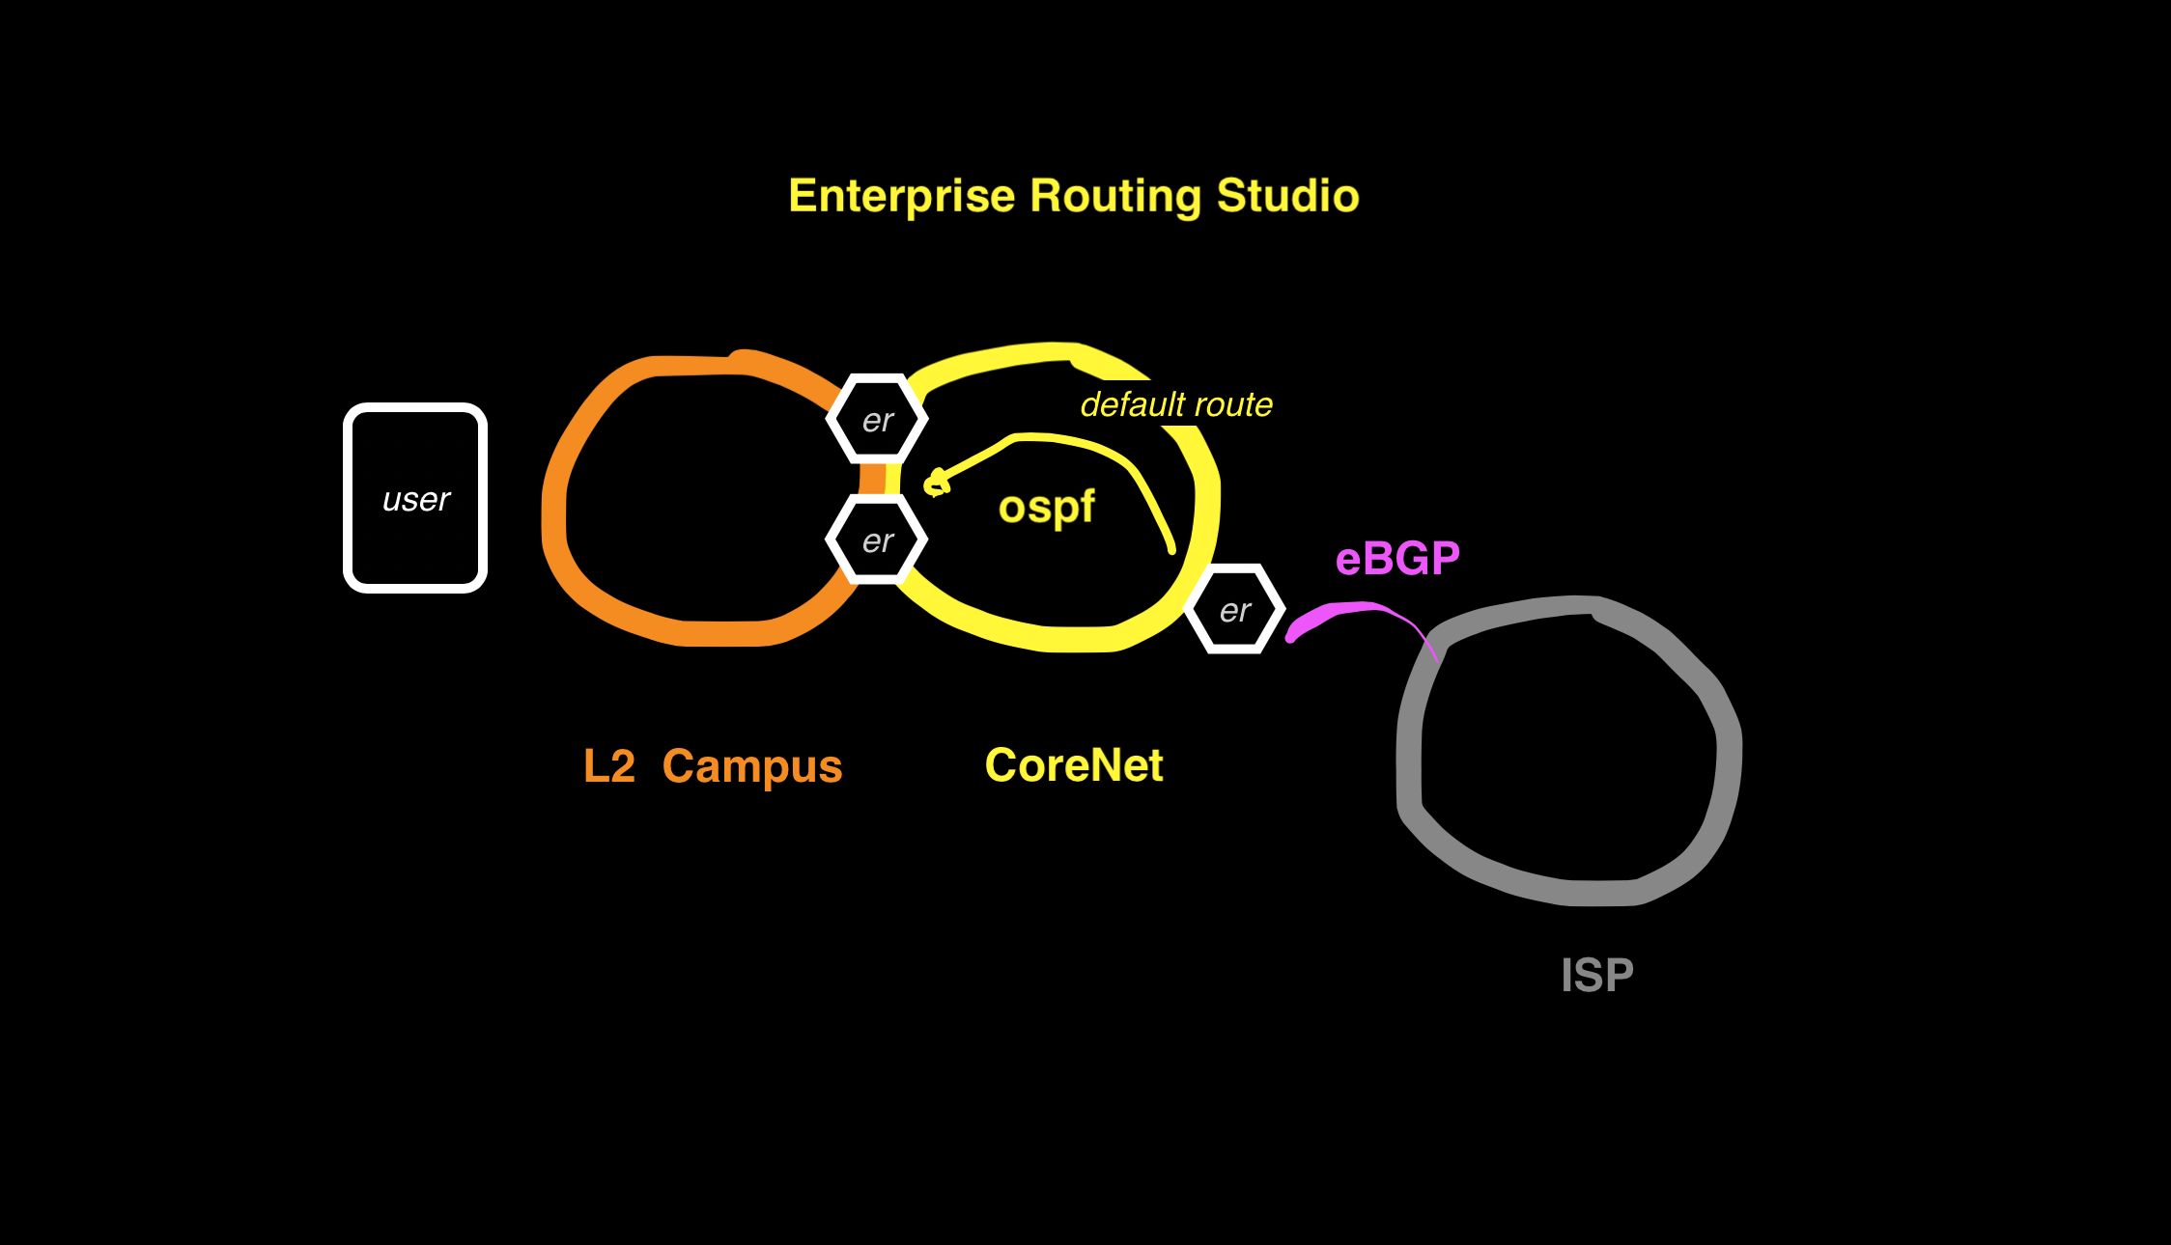
Example 4 Routing Campus to ISP, OSPF & eBGP

Slide 37
Example4: Routing OSPF Campus and eBGP to ISP Campus receives Default Route Campus edge router has full Internet routes
In this example the Enterprise Routing Studio, consisting of 3 Edge Routers route a Campus to the Internet
ISP sends full routes but Edge Router sends only a default route to the Campus Splines
Ping from Campus switch eos12 15.15.15.4/24 to eos10 on ISP network 10.10.10.10

Slide 38
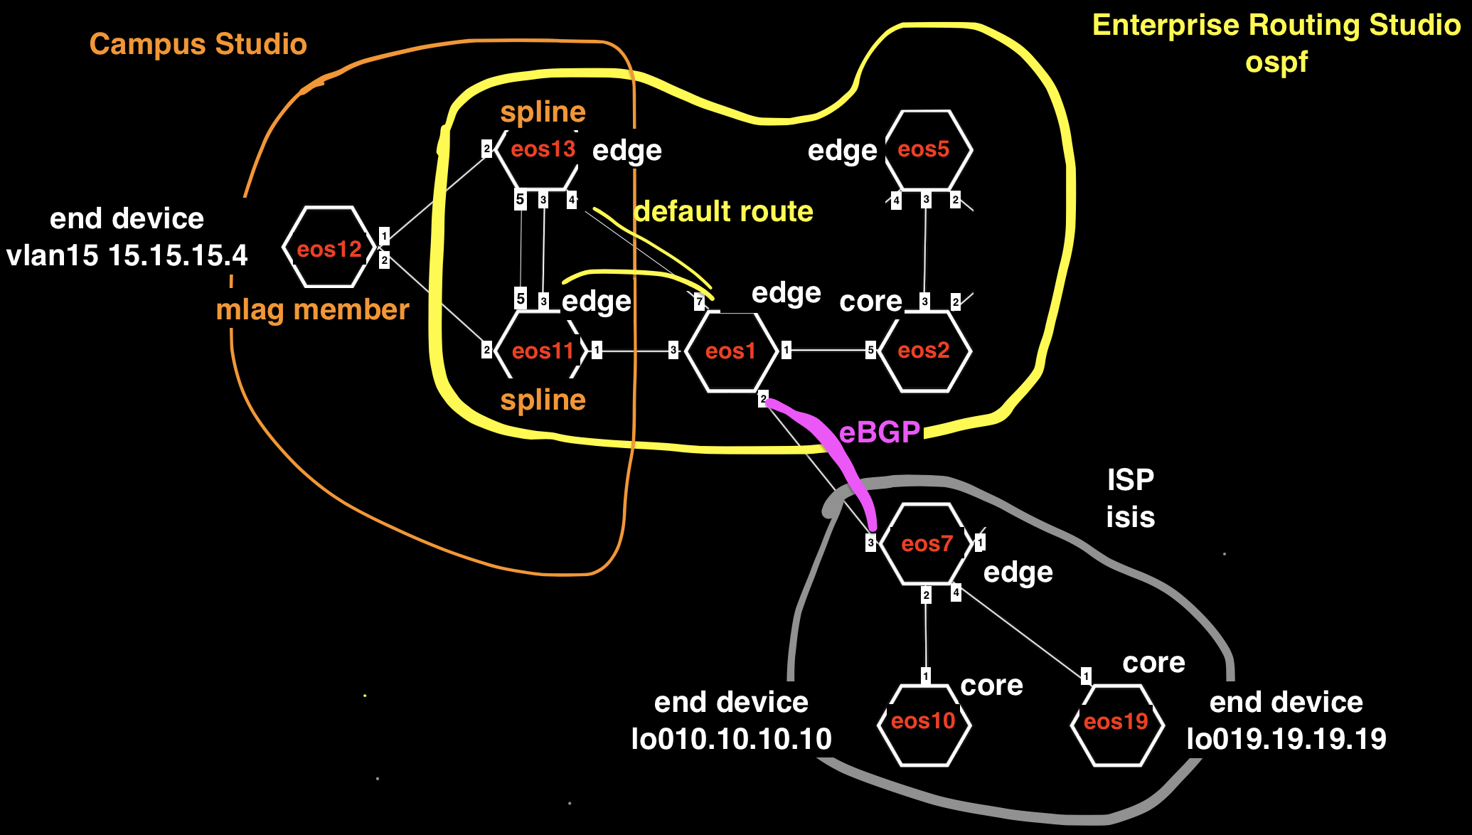
Example4:
core
edge

Slide 39
Example 4 Tags
 | eos1 | eos2 | eos5 | eos7 | eos10 | eos11 | eos12 | eos13 | eos19
Network Tag | Network:CoreNet | Network:CoreNet | Network:CoreNet | Network:ISP | Network:ISP | Network:CoreNet |  | Network:CoreNet | Network:ISP
Role Tag | Role:Core | Role:Edge-Router | Role:Edge-Router | Role:Edge-Router | Role:Core | Role:Edge-Router |  | Role:Edge-Router | Role:Core
Edge Router Domain |  | Edge-Router-Domain:Campus2-5-3-4 | Edge-Router-Domain:Campus2-5-3-4 | Edge-Router-Domain:7 |  | Edge-Router-Domain:Campus11-12-13 |  | Edge-Router-Domain:Campus11-12-13
Roter ID Tag |  |  |  | router_bgp.router_id:7.7.7.7 | router_bgp.router_id:10.10.10.10 |  |  |  | router_bgp.router_id:19.19.19.19
Campus Tag |  |  |  |  |  | Campus:Campus11-12-13 | Campus:Campus11-12-13 | Campus:Campus11-12-13
Campus Pod Tag |  |  |  |  |  |  | Campus-Pod:12

Slide 41
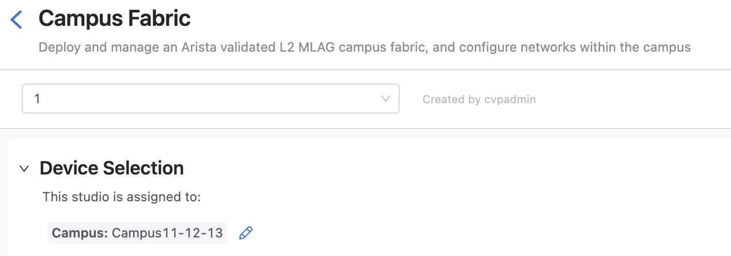
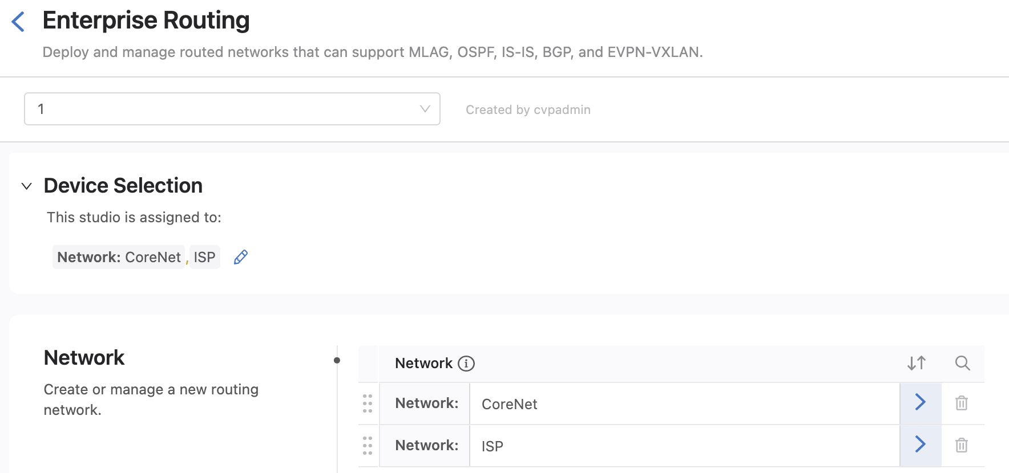
Device Selection

Slide 42
Test
From Campus switch eos12 ping to eos10 on the ISP network 10.10.10.10

Slide 43
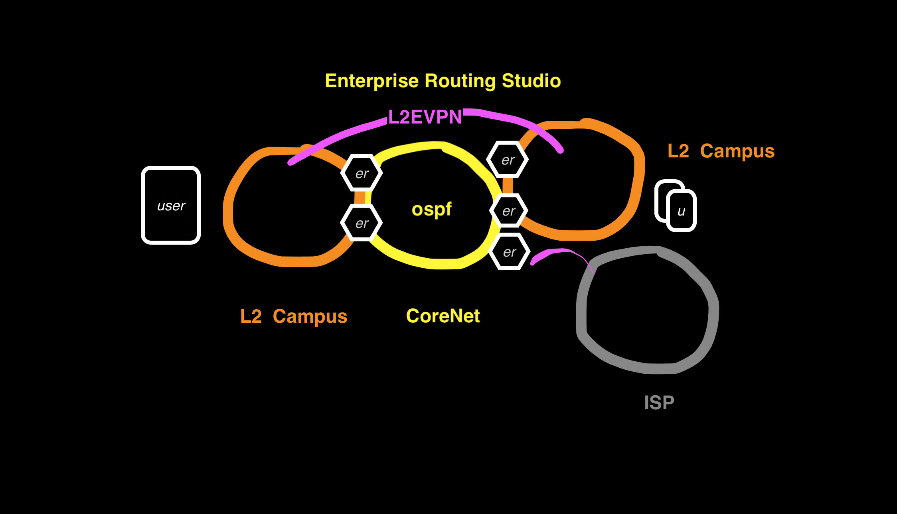
Example 5 Routing Campus to Campus + EVPN

Slide 44
Example5: Routing OSPF Campus to Campus + L2 vlan stretch between Campus
In this example the Enterprise Routing Studio, consisting of 3 Edge Routers route a Campus to the Internet
ISP sends full routes but Edge Router sends only a default route to the Campus Splines
Ping from Campus switch eos12 15.15.15.4/24 to eos10 on ISP network 10.10.10.10

Slide 45
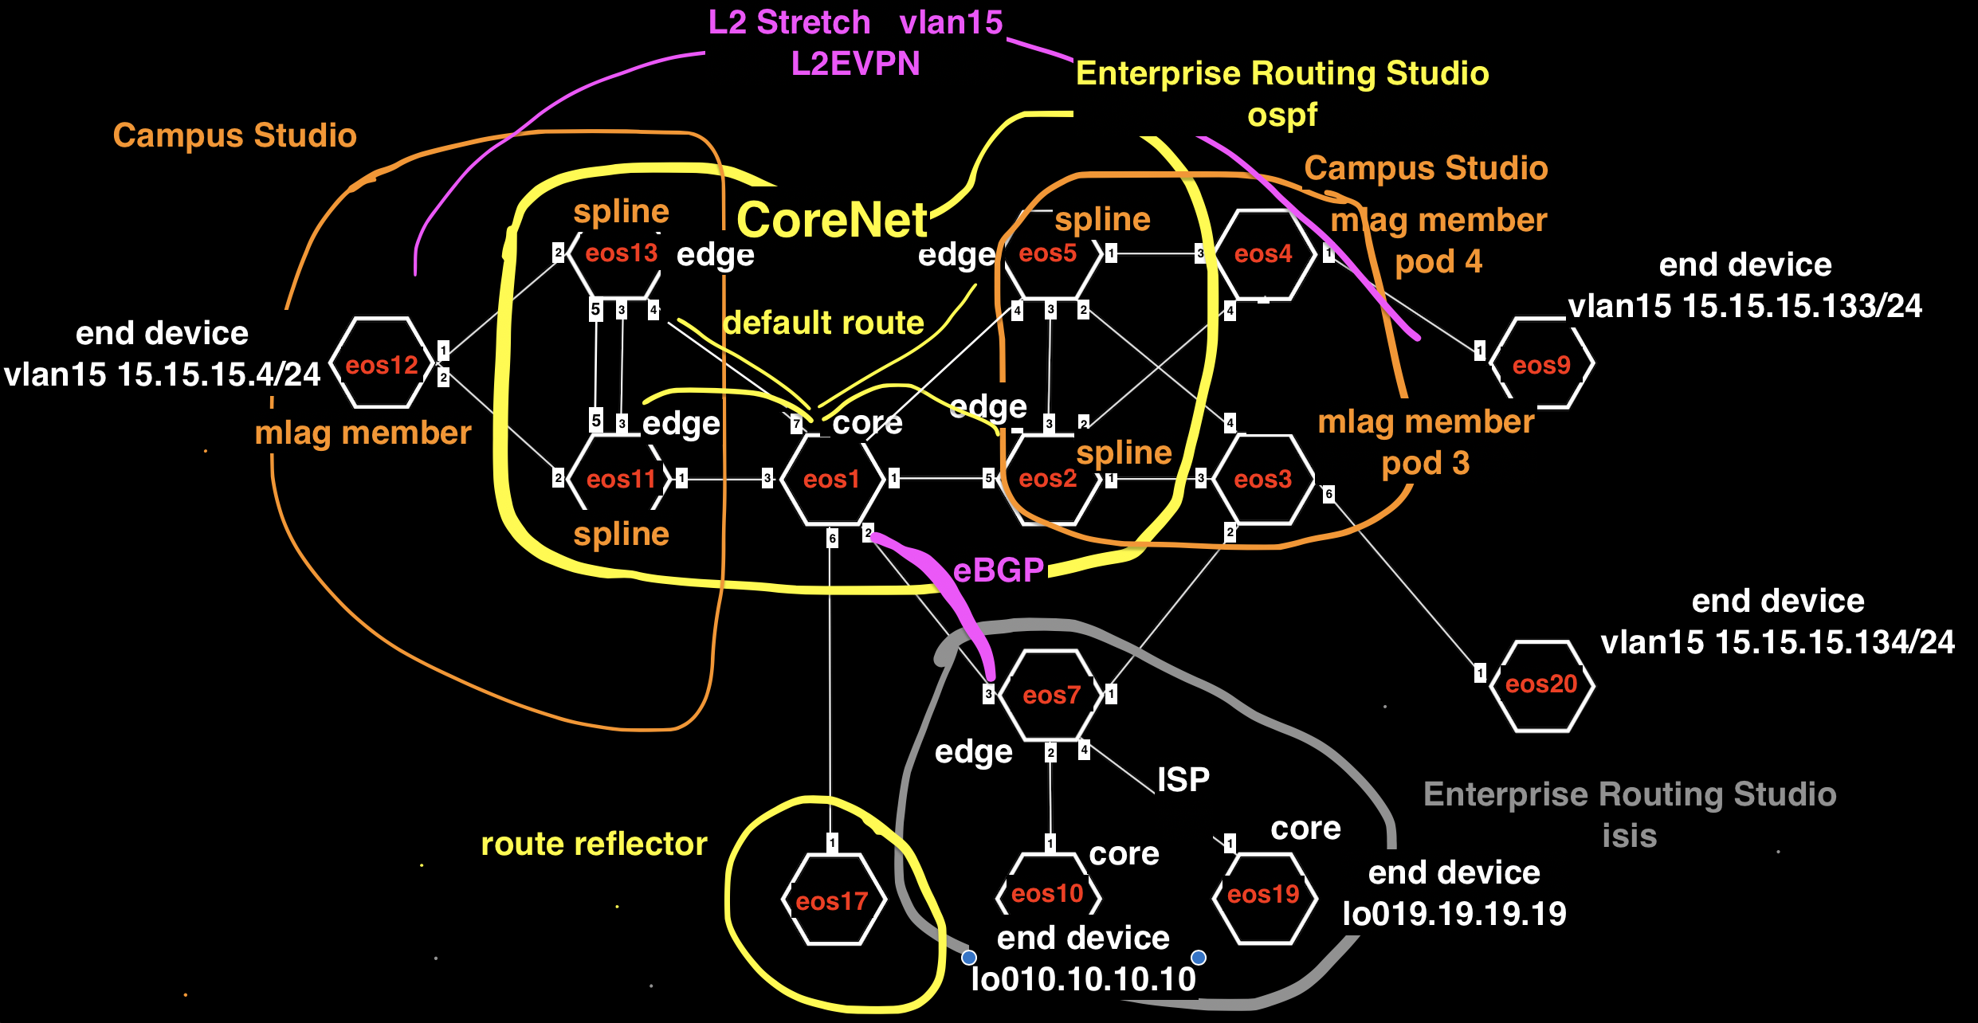
Example5: Routing Campus to Campus + EVPN

Slide 46
Example 5 Tags
 | eos1 | eos2 | eos5 | eos7 | eos10 | eos11 | eos12 | eos13 | eos19 | eos3 | eos20 | eos4 | eos17 | eos9
Network Tag | Network:CoreNet | Network:CoreNet | Network:CoreNet |  | Network:ISP | Network:CoreNet |  | Network:CoreNet | Network:ISP |  | Network:Campus2-5-3-4EndDevice3 |  | Network:CoreNet | Network:Campus2-5-3-4EndDevice4
Role Tag | Role:Core | Role:Edge-Router | Role:Edge-Router | Role:Edge-Router | Role:Core | Role:Edge-Router |  | Role:Edge-Router | Role:Core |  | Role:Edge-Router |  | Role:RR | Role:Edge-Router
Edge Router Domain Tag |  | Edge-Router-Domain:Campus2-5-3-4 | Edge-Router-Domain:Campus2-5-3-4 | Edge-Router-Domain:7 |  | Edge-Router-Domain:Campus11-12-13 |  | Edge-Router-Domain:Campus11-12-13 |  |  | Edge-Router-Domain:20 |  |  | Edge-Router-Domain:9
Router ID Tag (lo0) |  | router_bgp.router_id:2.2.2.2 | router_bgp.router_id:5.5.5.5 | router_bgp.router_id:7.7.7.7 | router_bgp.router_id:10.10.10.10 | router_bgp.router_id:11.11.11.11 |  | router_bgp.router_id:13.13.13.13 | router_bgp.router_id:19.19.19.19 |  |  |  | router_bgp.router_id:17.17.17.17
Campus Tag |  | ` | Campus:Campus2-5-3-4 |  |  | Campus:Campus11-12-13 | Campus:Campus11-12-13 | Campus:Campus11-12-13 |  | Campus:Campus2-5-3-4 |  | Campus:Campus2-5-3-4
Campus Pod Tag |  |  |  |  |  |  | Campus-Pod:12 |  |  | Campus-Pod:3 |  | Campus-Pod:4

Slide 48
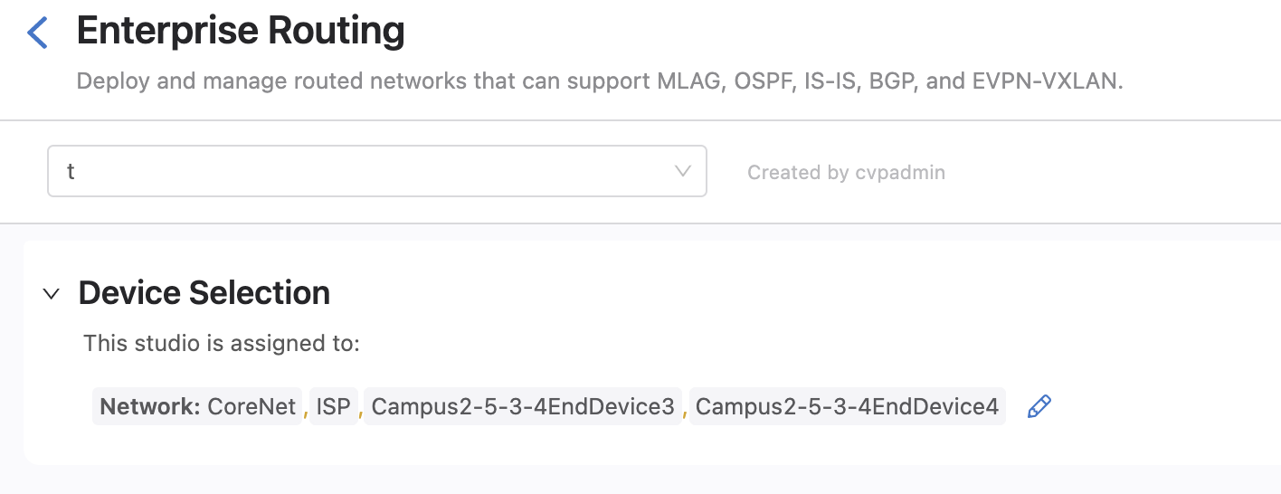
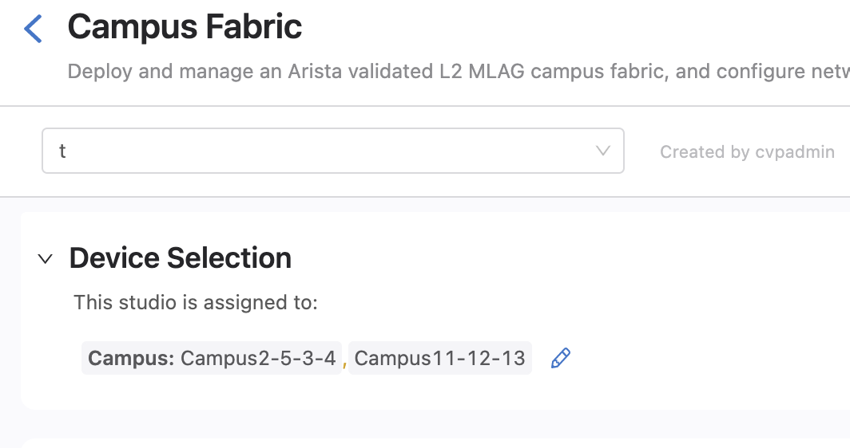
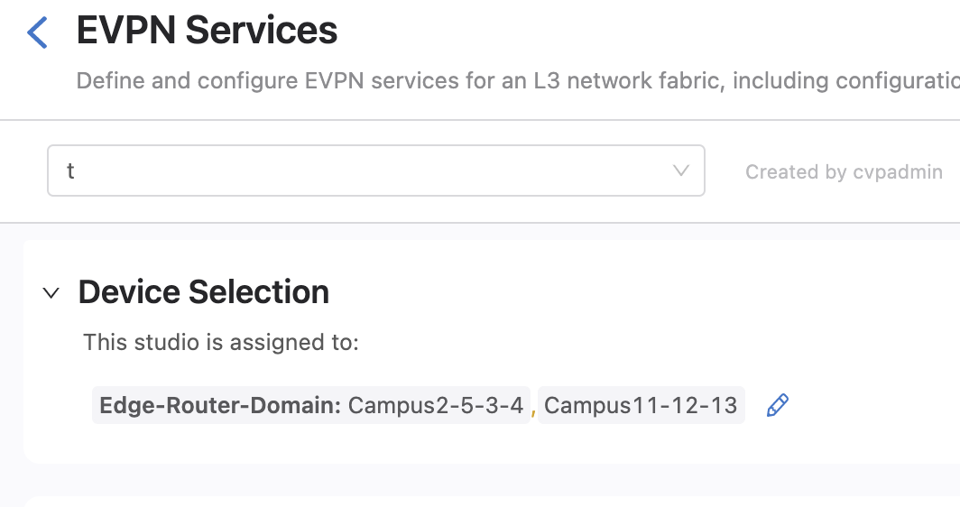

Device Selection

Slide 49
Test
From Campus switch eos12 ping DC end device eos9 15.15.15.2
From Campus switch eos12 ping to eos10 on the ISP network 10.10.10.10
From DC end device ping eos10 on ISP network 10.10.10.10

Slide 50

Example 6 Border Leaf OSPF to Enterprise Core

Slide 51
Example6: Border Leaf OSPF to Enterprise Core L3 DC has no overlay and runs OSPF on Border Leafs
In this example the Enterprise Routing Studio, consisting of 4 Edge Routers and 2 Core Routers routes a L3DC using L3LS Studio to an L2 DC using the Campus Studio.
On the border leafs on the L3 DC BGP to OSPF redistribution is configured using the Enterprise Routing Studio
Border Leafs are set to the same ASN in the L3LS Studio to prevent routing loops

Slide 52

Example6:

Slide 53
Example 6 Tags
 | eos1 | eos6 | eos12 | eos11 | eos13 | eos2 | eos5 | eos3 | eos4 | eos9
Network Tags | Network:CoreNet | Network:CoreNet |  | Network:CoreNet | Network:CoreNet | Network:CoreNet | Network:CoreNet |  |  | Network:L3EVPN-DC-End-device
Role Tags | Role:Core | Role:Core |  | Role:Edge-Router | Role:Edge-Router | Role:Edge-Router | Role:Edge-Router |  |  | Role:Edge-Router
Other Role Tags |  |  |  |  |  | Role:Leaf | Role:Leaf | Role:Spine | Role:Spine | Role:Leaf
Edge Router Domain Tags |  |  |  | Edge-Router-Domain:11-13 | Edge-Router-Domain:11-13 | Edge-Router-Domain:2 | Edge-Router-Domain:5 |  |  | Edge-Router-Domain:9
Router ID Tag (lo0) | router_bgp.router_id:1.1.1.1 | router_bgp.router_id:6.6.6.6 |  | router_bgp.router_id:11.11.11.11 | router_bgp.router_id:13.13.13.13
DC Tags |  |  |  |  |  | DC:L3DC DC-Pod:1 | DC:L3DC DC-Pod:1 | DC:L3DC DC-Pod:1 | DC:L3DC DC-Pod:1 | DC:L3DC DC-Pod:1
Leaf Domain Tags |  |  |  |  |  | Leaf-Domain:2 | Leaf-Domain:5 |  |  | Leaf-Domain:9
Number Tags |  |  |  |  |  | Leaf-Number:2 | Leaf-Number:5 | Spine-Number:3 | Spine-Number:4 | Leaf-Number:9
Campus Tags |  |  | Campus:L2DC | Campus:L2DC | Campus:L2DC |  |  |  |  | Campus:L3EVPN-DC-End-device
Campus Pod Tags |  |  | Campus-Pod:Leaf1

Slide 54


Slide 55



Device Selection

Slide 56
Test
From Campus switch eos12 ping DC Leaf eos9 14.14.14.2
From DC Leaf eos9 14.14.14.2 ping Campus switch eos12

Slide 57

Example 7 OSPF per Border Leaf VRF

Slide 58
Example7: OSPF per Border Leaf VRF L3 DC has EVPN overlay and runs OSPF on Border Leafs in VRF
In this example the Enterprise Routing Studio, consisting of 4 Edge Routers and 2 Core Routers routes a L3DC using L3LS Studio to an L2 DC using the Campus Studio.
On the border leafs on the L3 DC BGP to OSPF redistribution is configured using the Enterprise Routing Studio
Border Leafs are set to the same ASN in the L3LS Studio to prevent routing loops

Slide 59

Example7:

Slide 60
Example 7 Tags
 | eos1 | eos6 | eos12 | eos11 | eos13 | eos2 | eos5 | eos3 | eos4 | eos9
Network Tags | Network:CoreNet | Network:CoreNet |  | Network:CoreNet | Network:CoreNet | Network:CoreNet | Network:CoreNet |  |  | Network:L3EVPN-DC-End-device
Role Tags | Role:Core | Role:Core |  | Role:Edge-Router | Role:Edge-Router | Role:Edge-Router | Role:Edge-Router |  |  | Role:Edge-Router
Other Role Tags |  |  |  |  |  | Role:Leaf | Role:Leaf | Role:Spine | Role:Spine | Role:Leaf
Edge Router Domain Tags |  |  |  | Edge-Router-Domain:11-13 | Edge-Router-Domain:11-13 | Edge-Router-Domain:2 | Edge-Router-Domain:5 |  |  | Edge-Router-Domain:9
Router ID Tag (lo0) | router_bgp.router_id:1.1.1.1 | router_bgp.router_id:6.6.6.6 |  | router_bgp.router_id:11.11.11.11 | router_bgp.router_id:13.13.13.13
DC Tags |  |  |  |  |  | DC:L3DC DC-Pod:1 | DC:L3DC DC-Pod:1 | DC:L3DC DC-Pod:1 | DC:L3DC DC-Pod:1 | DC:L3DC DC-Pod:1
Leaf Domain Tags |  |  |  |  |  | Leaf-Domain:2 | Leaf-Domain:5 |  |  | Leaf-Domain:9
Number Tags |  |  |  |  |  | Leaf-Number:2 | Leaf-Number:5 | Spine-Number:3 | Spine-Number:4 | Leaf-Number:9
Campus Tags |  |  | Campus:L2DC | Campus:L2DC | Campus:L2DC |  |  |  |  | Campus:L3EVPN-DC-End-device
Campus Pod Tags |  |  | Campus-Pod:Leaf1

Slide 61


Slide 62




Device Selection

Slide 63
Test
From Campus switch eos12 ping DC Leaf eos9 14.14.14.2
From DC Leaf eos9 14.14.14.2 ping Campus switch eos12

Slide 64

Example 8 BGP Enterprise Core Non-Overlay DC

Slide 65
Example8: BGP Enterprise Core eBGP to Border Leafs, Overlay enabled DC
In this example the Enterprise Routing Studio, consisting of 2 Edge Routers in a Camus, 2 Core Routers and 2 Edge Routers in L3DC

Slide 66

Example7:

Slide 67
Example 8 Tags
 | eos1 | eos6 | eos12 | eos11 | eos13 | eos2 | eos5 | eos3 | eos4 | eos9
Network Tags | Network:CoreNet | Network:CoreNet |  | Network:L2DC | Network:L2DC | Network:L3DC | Network:L3DC |  |  | Network:L3EVPN-DC-End-device
Role Tags | Role:Core | Role:Core |  | Role:Edge-Router | Role:Edge-Router | Role:Edge-Router | Role:Edge-Router |  |  | Role:Edge-Router
Other Role Tags |  |  |  |  |  | Role:Leaf | Role:Leaf | Role:Spine | Role:Spine | Role:Leaf
Edge Router Domain Tags |  |  |  | Edge-Router-Domain:11-13 | Edge-Router-Domain:11-13 | Edge-Router-Domain:2 | Edge-Router-Domain:5 |  |  | Edge-Router-Domain:9
DC Tags |  |  |  |  |  | DC:L3DC DC-Pod:1 | DC:L3DC DC-Pod:1 | DC:L3DC DC-Pod:1 | DC:L3DC DC-Pod:1 | DC:L3DC DC-Pod:1
Leaf Domain |  |  |  |  |  | Leaf-Domain:2 | Leaf-Domain:5 |  |  | Leaf-Domain:9
Number Tags |  |  |  |  |  | Leaf-Number:1 | Leaf-Number:5 | Spine-Number:1 | Spine-Number:2 | Leaf-Number:9
Campus Tags |  |  | Campus:L2DC | Campus:L2DC | Campus:L2DC |  |  |  |  | Campus:L3EVPN-DC-End-device
Campus Pod Tags |  |  | Campus-Pod:Leaf1

Slide 68


Slide 69



Device Selection

Slide 70
Test
From Campus switch eos12 ping DC Leaf eos9 14.14.14.2
From DC Leaf eos9 14.14.14.2 ping Campus switch eos12

Slide 71

Example 9 VRF Lite, Overlay DC

Slide 72
Example9: VRF Lite Core and DC w Overlay L3DC EVPN/VXLAN Overlay enabled
In this example the Enterprise Routing Studio, consisting of 2 Edge Routers in a Camus, 2 Core Routers and 2 Edge Routers in L3DC

Slide 73

Example9:

Slide 74
Example 9 Tags
 | eos1 | eos6 | eos12 | eos11 | eos13 | eos2 | eos5 | eos3 | eos4 | eos9
Network Tags | Network:CoreNet | Network:CoreNet |  | Network:L2DC | Network:L2DC | Network:L3DC | Network:L3DC |  |  | Network:L3EVPN-DC-End-device
Role Tags | Role:Core | Role:Core |  | Role:Edge-Router | Role:Edge-Router | Role:Edge-Router | Role:Edge-Router |  |  | Role:Edge-Router
Other Role Tags |  |  |  |  |  | Role:Leaf | Role:Leaf | Role:Spine | Role:Spine | Role:Leaf
Edge Router Domain Tags |  |  |  | Edge-Router-Domain:11-13 | Edge-Router-Domain:11-13 | Edge-Router-Domain:2 | Edge-Router-Domain:5 |  |  | Edge-Router-Domain:9
DC Tags |  |  |  |  |  | DC:L3DC DC-Pod:1 | DC:L3DC DC-Pod:1 | DC:L3DC DC-Pod:1 | DC:L3DC DC-Pod:1 | DC:L3DC DC-Pod:1
Leaf Domain |  |  |  |  |  | Leaf-Domain:2 | Leaf-Domain:5 |  |  | Leaf-Domain:9
Number Tags |  |  |  |  |  | Leaf-Number:1 | Leaf-Number:5 | Spine-Number:1 | Spine-Number:2 | Leaf-Number:9
Campus Tags |  |  | Campus:L2DC | Campus:L2DC | Campus:L2DC |  |  |  |  | Campus:L3EVPN-DC-End-device
Campus Pod Tags |  |  | Campus-Pod:Leaf1

Slide 76

Device Selection

Slide 77
Test
From Campus switch eos12 ping DC Leaf eos9 14.14.14.2

